Slide 1
CSE 417T Introduction to Machine Learning
Lecture 18 Instructor: Chien-Ju (CJ) Ho

Slide 2
Logistics
No class on Nov 22 (Tuesday): The day before the thanksgiving break
Exam 1 is returned on Gradescope
Homework 4 is due November 14 (Monday)
Keep track of your own late days
Gradescope doesn’t allow separate deadlines
Your submissions won’t be graded if you exceed the late-day limit
Homework 5 will be announced early next week
This will be our last assignment

Slide 3
Recap

Slide 4
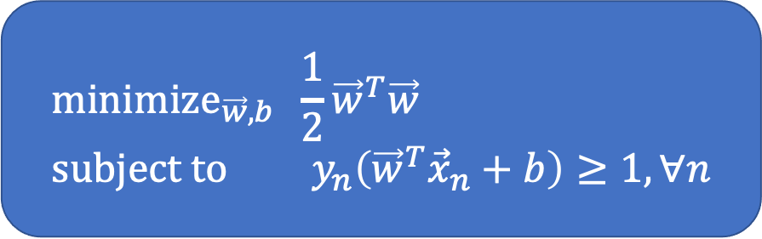
Support Vector Machine
Goal: Find the max-margin linear separator that separates the data
Hard-Margin SVM (Assume data is linearly separable)
Solvable using Quadratic Program (QP)
Given solution $\left({\vec{w}}^{∗}, b^{∗}\right),$ the learned hypothesis $g\left(\vec{x}\right)=sign({{\vec{w}}^{∗}}^{T}\vec{x}+b^{∗})$
Margin
$${\text{minimize}}_{\vec{w},b} \frac{1}{2}{\vec{w}}^{T}\vec{w} \\ \text{subject} \text{to} y_{n}\left({\vec{w}}^{T}{\vec{x}}_{n}+b\right)≥1, ∀n$$

Slide 5
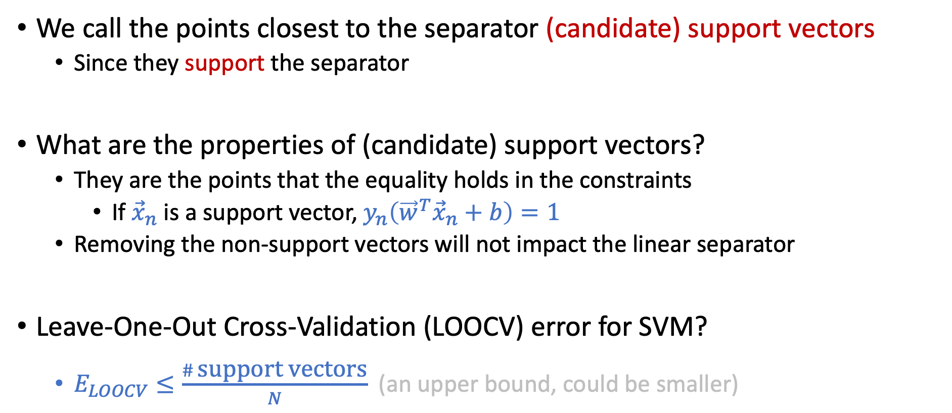
Support Vectors
We call the points closest to the separator (candidate) support vectors
Since they support the separator
What are the properties of (candidate) support vectors?
They are the points that the equality holds in the constraints
If ${\vec{x}}_{n}$ is a support vector, $y_{n}\left({\vec{w}}^{T}{\vec{x}}_{n}+b\right)=1$
Removing the non-support vectors will not impact the linear separator
Leave-One-Out Cross-Validation (LOOCV) error for SVM?
$E_{LOOCV}≤\frac{\# \text{support} \text{vectors}}{N}$ (an upper bound, could be smaller)

Slide 6
Non-Separable Data
Two scenarios
Tolerate some noise
Soft-Margin SVM
Nonlinear transform
Dual formulation and kernel tricks

Slide 7
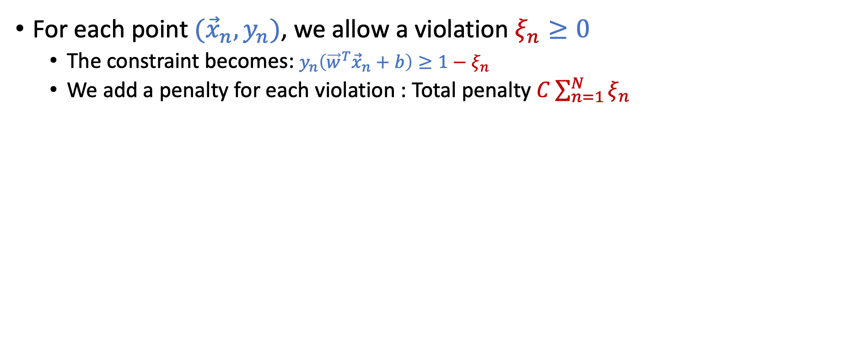
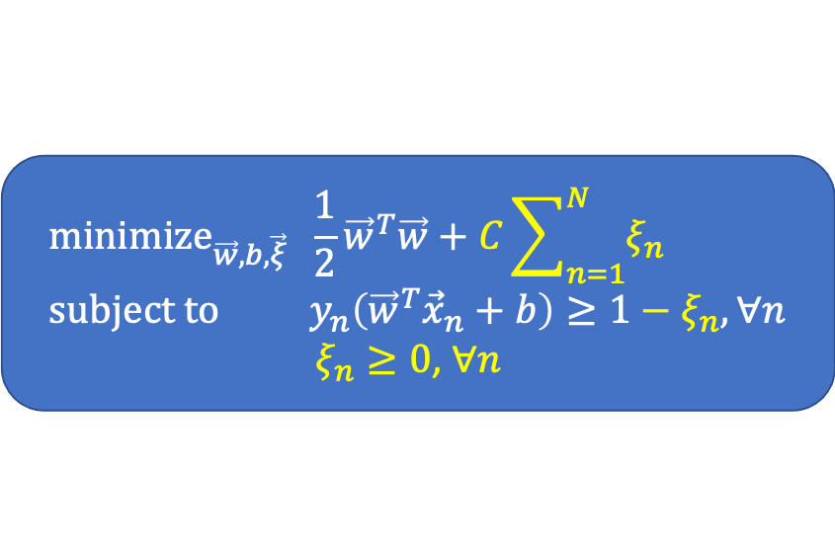
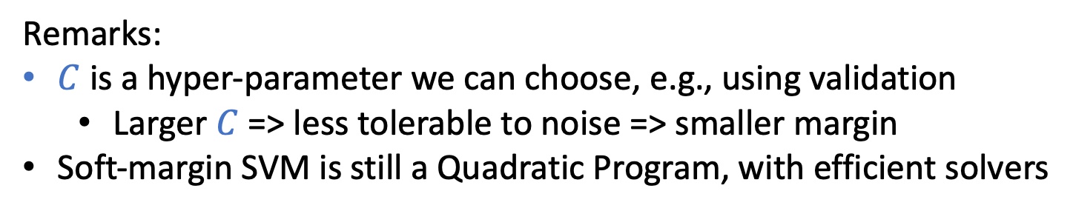
Soft-Margin SVM
For each point $({\vec{x}}_{n},y_{n})$, we allow a violation $ξ_{n}≥0$
The constraint becomes: $y_{n}\left({\vec{w}}^{T}{\vec{x}}_{n}+b\right)≥1−ξ_{n}$
We add a penalty for each violation : Total penalty $C\sum_{n=1}^{N}{ξ_{n}}$
$${\text{minimize}}_{\vec{w},b,\vec{ξ}} \frac{1}{2}{\vec{w}}^{T}\vec{w}+C\sum_{n=1}^{N}{ξ_{n}} \\ \text{subject} \text{to} y_{n}\left({\vec{w}}^{T}{\vec{x}}_{n}+b\right)≥1−ξ_{n}, ∀n$$
$ξ_{n}≥0$, $∀n$
Remarks:
$C$ is a hyper-parameter we can choose, e.g., using validation
Larger $C$ => less tolerable to noise => smaller margin
Soft-margin SVM is still a Quadratic Program, with efficient solvers

Slide 8
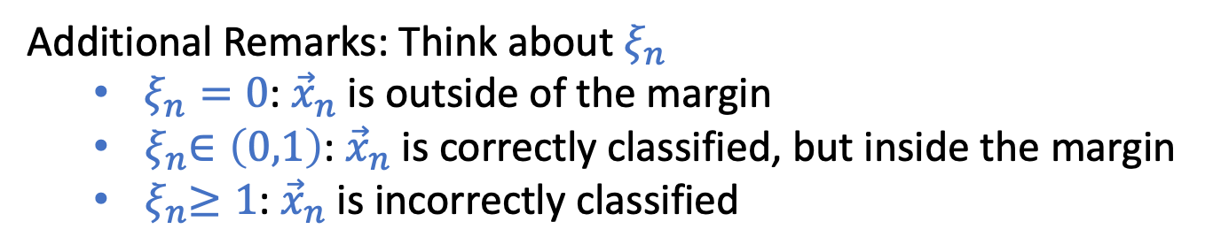
Soft-Margin SVM
For each point $({\vec{x}}_{n},y_{n})$, we allow a violation $ξ_{n}≥0$
The constraint becomes: $y_{n}\left({\vec{w}}^{T}{\vec{x}}_{n}+b\right)≥1−ξ_{n}$
We add a penalty for each violation : Total penalty $C\sum_{n=1}^{N}{ξ_{n}}$
$${\text{minimize}}_{\vec{w},b,\vec{ξ}} \frac{1}{2}{\vec{w}}^{T}\vec{w}+C\sum_{n=1}^{N}{ξ_{n}} \\ \text{subject} \text{to} y_{n}\left({\vec{w}}^{T}{\vec{x}}_{n}+b\right)≥1−ξ_{n}, ∀n$$
$ξ_{n}≥0$, $∀n$
Additional Remarks: Think about $ξ_{n}$
$ξ_{n}=0$: ${\vec{x}}_{n}$ is outside of the margin
${ ξ}_{n}∈\left(0,1\right)$: ${\vec{x}}_{n}$ is correctly classified, but inside the margin
${ ξ}_{n}≥1$: ${\vec{x}}_{n}$ is incorrectly classified

Slide 9
What if Tolerating Small Noises Is Not Enough
Nonlinear transform
We can apply standard nonlinear transformation procedure we talked about before
In SVM, we can combine the ideas of dual formulation and kernel tricks for the transformation
This is one of the key ingredients that makes SVM powerful

Slide 10
Today’s Lecture
(Get prepared for heavier math today…)
The notes are not intended to be comprehensive. They should be accompanied by lectures and/or textbook.
Let me know if you spot errors.
Notes:
This is the lecture I wish I have 6 chalkboards to utilize

Slide 11
Lagrangian Duality and Convex Optimization
[The next few slides are safe to skip for the exam, but they contain useful concepts for optimization/ML]

Slide 12
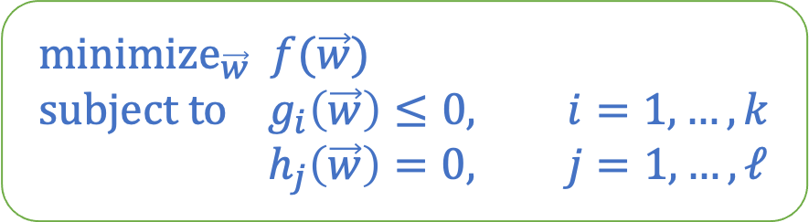
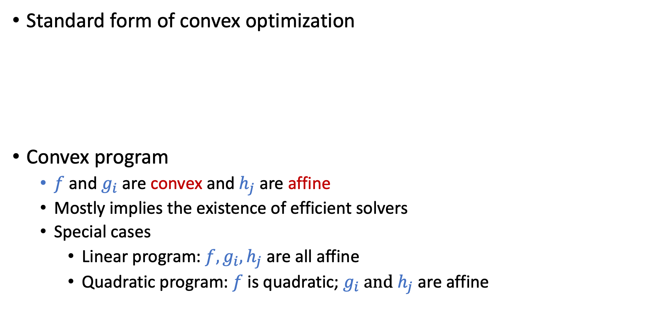
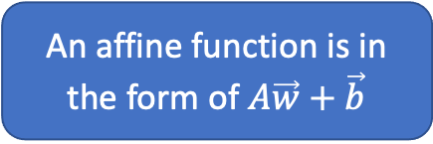
Convex Optimization
Standard form of convex optimization
Convex program
$f$ and $g_{i}$ are convex and $h_{j}$ are affine
Mostly implies the existence of efficient solvers
Special cases
Linear program: $f, g_{i}, h_{j}$ are all affine
Quadratic program: $f$ is quadratic; $g_{i} and$ $h_{j}$ are affine
Objective
$${\text{minimize}}_{\vec{w}} f(\vec{w}) \\ \text{subject} \text{to} g_{i}\left(\vec{w}\right)≤0, i=1,…,k \\ h_{j}\left(\vec{w}\right)=0, j=1,…,ℓ$$
Inequality constraints
Equality constraints
An affine function is in the form of $A\vec{w}+\vec{b}$
[Safe to Skip for the Exam]

Slide 13
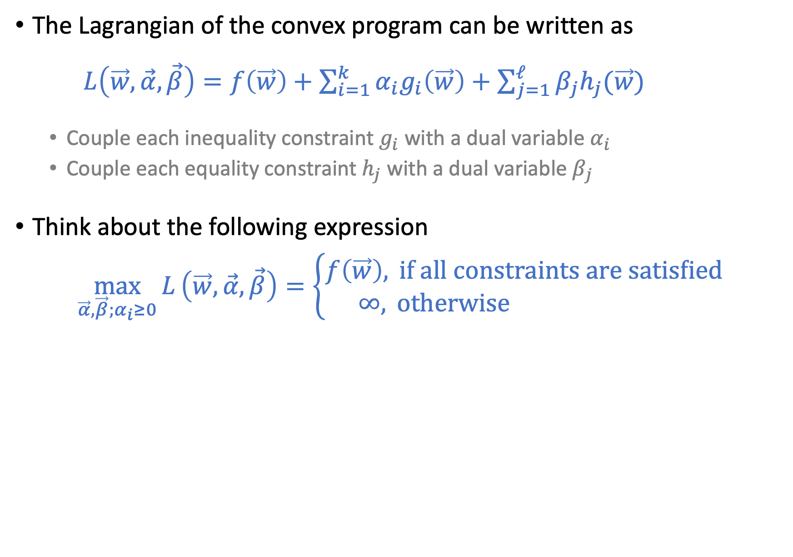
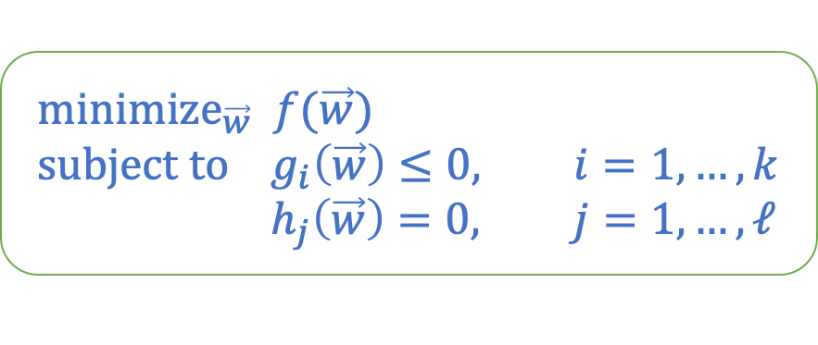
Lagrangian
$${\text{minimize}}_{\vec{w}} f(\vec{w}) \\ \text{subject} \text{to} g_{i}\left(\vec{w}\right)≤0, i=1,…,k \\ h_{j}\left(\vec{w}\right)=0, j=1,…,ℓ$$
The Lagrangian of the convex program can be written as
$L\left(\vec{w},\vec{α},\vec{β}\right)=f\left(\vec{w}\right)+\sum_{i=1}^{k}{α_{i}g_{i}\left(\vec{w}\right)+\sum_{j=1}^{ℓ}{β_{j}h_{j}(\vec{w})}}$
Couple each inequality constraint $g_{i}$ with a dual variable $α_{i}$
Couple each equality constraint $h_{j}$ with a dual variable $β_{j}$
Think about the following expression
$$\max_{\vec{α},\vec{β};α_{i}≥0}{L}\left(\vec{w},\vec{α},\vec{β}\right)=\left\{\begin{aligned}f\left(\vec{w}\right), \text{if} \text{all} \text{constraints} \text{are} \text{satisfied} \\ &∞, \text{otherwise} \end{aligned}\right.$$
[Safe to Skip for the Exam]

Slide 14
Lagrangian
$${\text{minimize}}_{\vec{w}} f(\vec{w}) \\ \text{subject} \text{to} g_{i}\left(\vec{w}\right)≤0, i=1,…,k \\ h_{j}\left(\vec{w}\right)=0, j=1,…,ℓ$$
The Lagrangian of the convex program can be written as
$L\left(\vec{w},\vec{α},\vec{β}\right)=f\left(\vec{w}\right)+\sum_{i=1}^{k}{α_{i}g_{i}\left(\vec{w}\right)+\sum_{j=1}^{ℓ}{β_{j}h_{j}(\vec{w})}}$
Couple each inequality constraint $g_{i}$ with a dual variable $α_{i}$
Couple each equality constraint $h_{j}$ with a dual variable $β_{j}$
Think about the following expression
$$\max_{\vec{α},\vec{β};α_{i}≥0}{L}\left(\vec{w},\vec{α},\vec{β}\right)=\left\{\begin{aligned}f\left(\vec{w}\right), \text{if} \text{all} \text{constraints} \text{are} \text{satisfied} \\ &∞, \text{otherwise} \end{aligned}\right.$$
[Safe to Skip for the Exam]

Slide 15
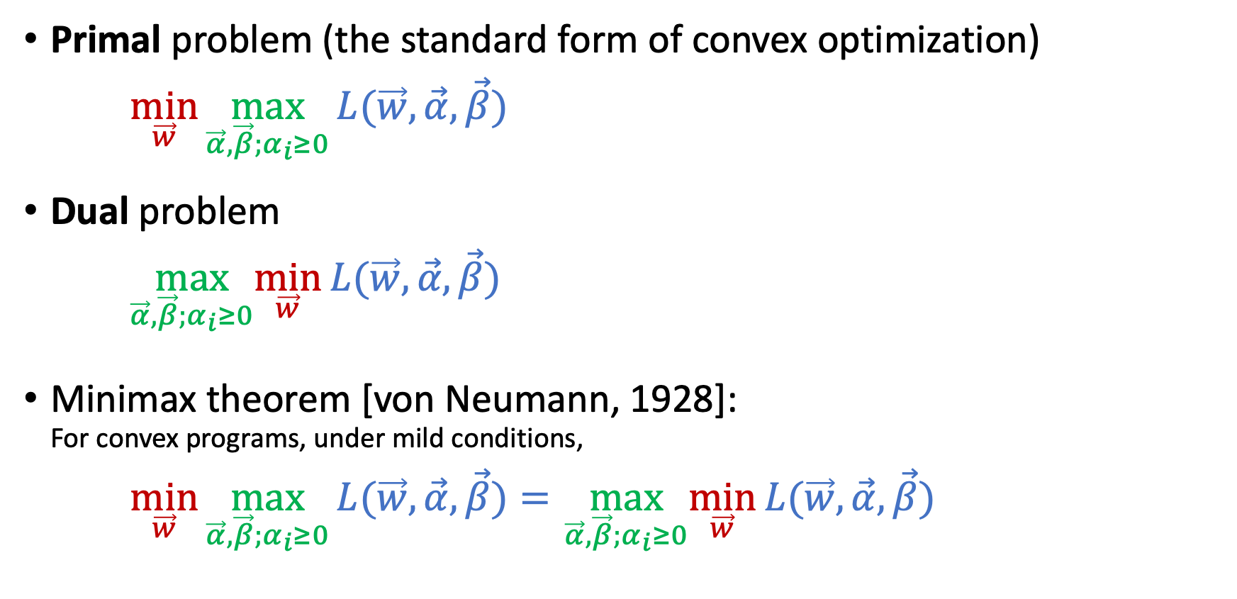
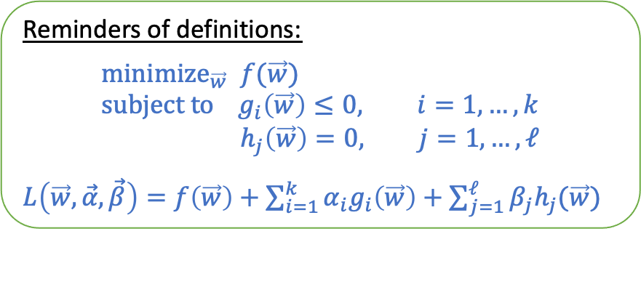
Primal-Dual Formulation
Primal problem (the standard form of convex optimization)
$\min_{\vec{w}}{\max_{\vec{α},\vec{β};α_{i}≥0}{L(\vec{w},\vec{α},\vec{β})}}$
Dual problem
$\max_{\vec{α},\vec{β};α_{i}≥0}\min_{\vec{w}}{L(\vec{w},\vec{α},\vec{β})}$
Minimax theorem [von Neumann, 1928]: For convex programs, under mild conditions,
$\min_{\vec{w}}{\max_{\vec{α},\vec{β};α_{i}≥0}{L(\vec{w},\vec{α},\vec{β})}=} \max_{\vec{α},\vec{β};α_{i}≥0}\min_{\vec{w}}{L(\vec{w},\vec{α},\vec{β}){}}$
Reminders of definitions:
$${\text{minimize}}_{\vec{w}} f(\vec{w}) \\ \text{subject} \text{to} g_{i}\left(\vec{w}\right)≤0, i=1,…,k \\ h_{j}\left(\vec{w}\right)=0, j=1,…,ℓ$$
$L\left(\vec{w},\vec{α},\vec{β}\right)=f\left(\vec{w}\right)+\sum_{i=1}^{k}{α_{i}g_{i}\left(\vec{w}\right)+\sum_{j=1}^{ℓ}{β_{j}h_{j}(\vec{w})}}$
[Safe to Skip for the Exam]

Slide 16
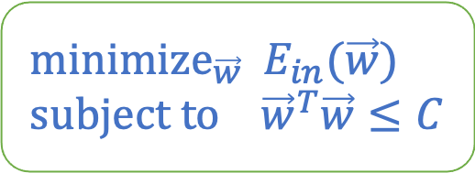
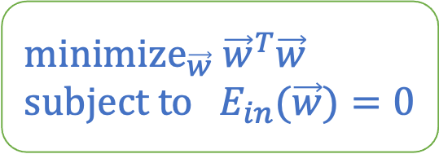
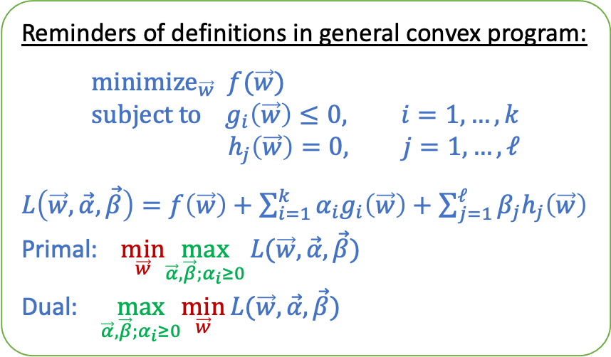
SVM and Regularization
Reminders of definitions in general convex program:
$${\text{minimize}}_{\vec{w}} f(\vec{w}) \\ \text{subject} \text{to} g_{i}\left(\vec{w}\right)≤0, i=1,…,k \\ h_{j}\left(\vec{w}\right)=0, j=1,…,ℓ$$
$L\left(\vec{w},\vec{α},\vec{β}\right)=f\left(\vec{w}\right)+\sum_{i=1}^{k}{α_{i}g_{i}\left(\vec{w}\right)+\sum_{j=1}^{ℓ}{β_{j}h_{j}\left(\vec{w}\right)}}$
Primal: $\min_{\vec{w}}\max_{\vec{α},\vec{β};α_{i}≥0}{L(\vec{w},\vec{α},\vec{β})}$
Dual: $\max_{\vec{α},\vec{β};α_{i}≥0}\min_{\vec{w}}{L(\vec{w},\vec{α},\vec{β})}$
Remember the weight-decay regularization:
And the hard-margin SVM
Use what we talked about to write the unconstrained optimization problem.
$${\text{minimize}}_{\vec{w}} E_{in}(\vec{w}) \\ \text{subject} \text{to} {\vec{w}}^{T}\vec{w}≤C$$
$${\text{minimize}}_{\vec{w}}{ \vec{w}}^{T}\vec{w} \\ \text{subject} \text{to} E_{in}(\vec{w})=0$$
[Safe to Skip for the Exam]

Slide 17
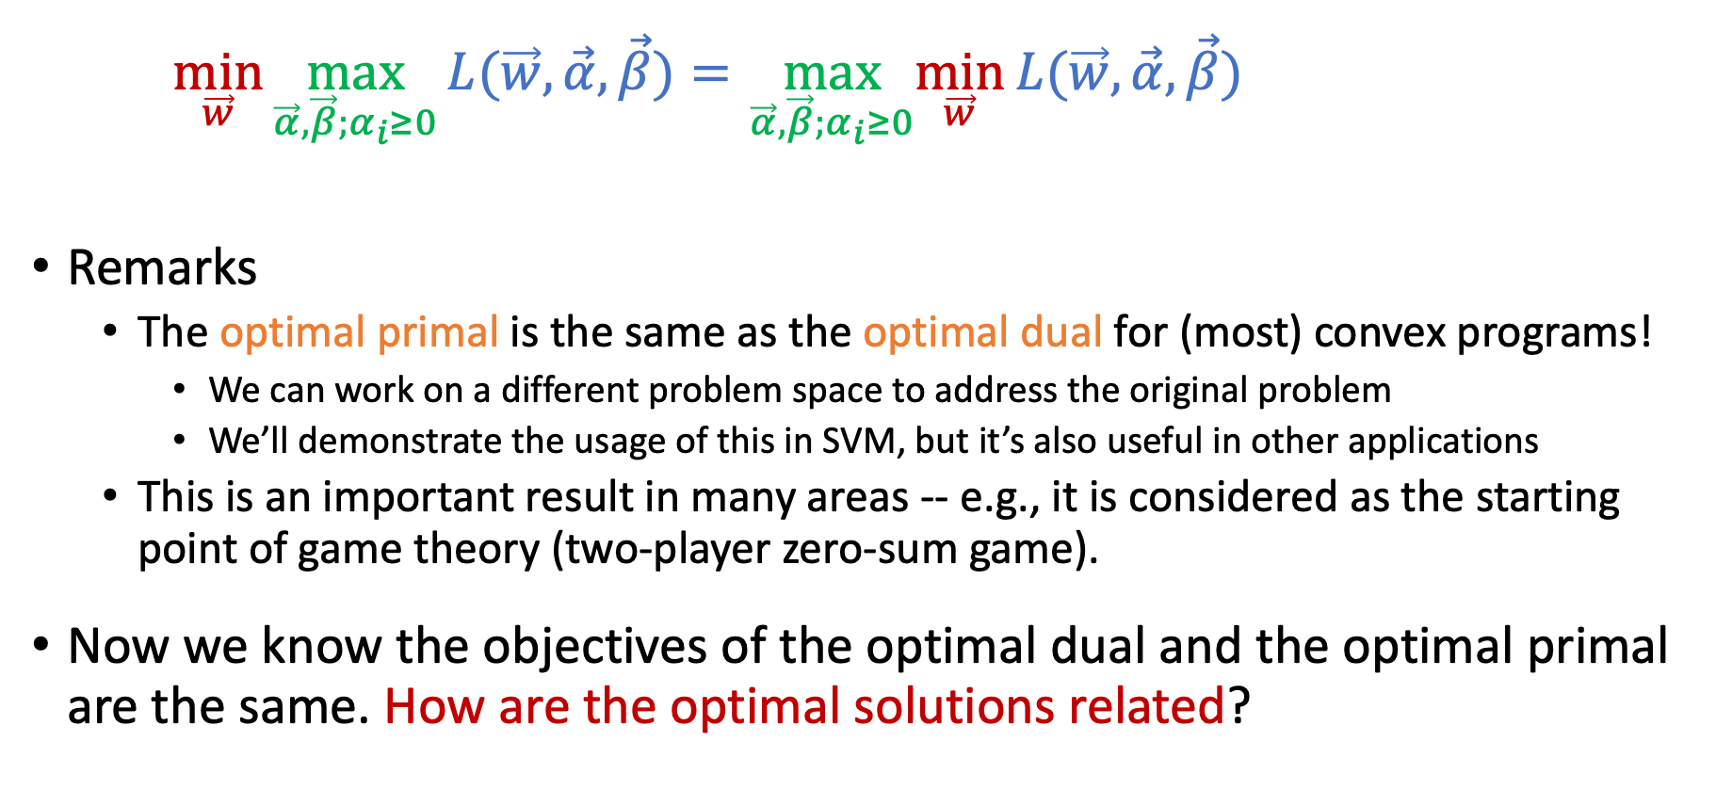
Minimax Theorem [von Neumann, 1928]
$\min_{\vec{w}}{\max_{\vec{α},\vec{β};α_{i}≥0}{L(\vec{w},\vec{α},\vec{β})}=} \max_{\vec{α},\vec{β};α_{i}≥0}\min_{\vec{w}}{L(\vec{w},\vec{α},\vec{β}){}}$
Remarks
The optimal primal is the same as the optimal dual for (most) convex programs!
We can work on a different problem space to address the original problem
We’ll demonstrate the usage of this in SVM, but it’s also useful in other applications
This is an important result in many areas -- e.g., it is considered as the starting point of game theory (two-player zero-sum game).
Now we know the objectives of the optimal dual and the optimal primal are the same. How are the optimal solutions related?
[Safe to Skip for the Exam]

Slide 18
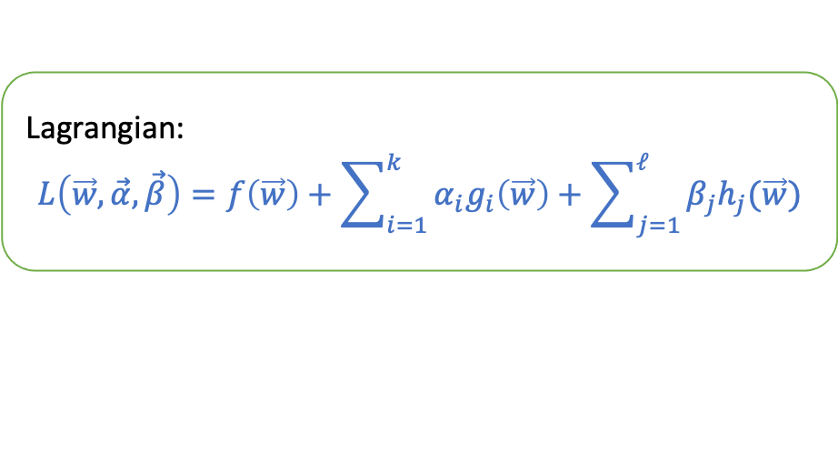
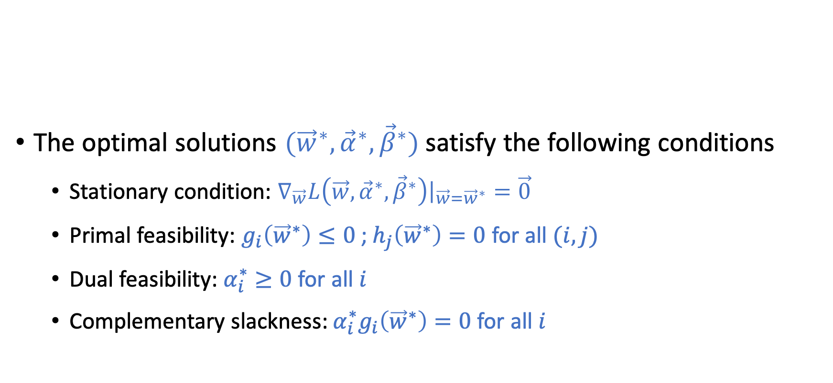
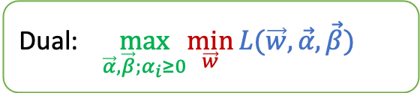
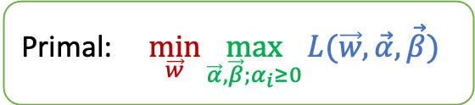
Karush-Kuhn-Tucker (KKT) Conditions
Primal: $\min_{\vec{w}}{\max_{\vec{α},\vec{β};α_{i}≥0}{L(\vec{w},\vec{α},\vec{β})}}$
Lagrangian: $$L\left(\vec{w},\vec{α},\vec{β}\right)=f\left(\vec{w}\right)+\sum_{i=1}^{k}{α_{i}g_{i}\left(\vec{w}\right)+\sum_{j=1}^{ℓ}{β_{j}h_{j}(\vec{w})}}$$
The optimal solutions $({{\vec{w}}^{∗},\vec{α}}^{∗},{\vec{β}}^{∗})$ satisfy the following conditions
Stationary condition: $∇_{\vec{w}}L\left(\vec{w},{\vec{α}}^{∗},{\vec{β}}^{∗}\right){\left.​\right|}_{\vec{w}={\vec{w}}^{∗}}=\vec{0}$
Primal feasibility: $g_{i}\left({\vec{w}}^{∗}\right)≤0$ ; $h_{j}\left({\vec{w}}^{∗}\right)=0$ for all $(i,j)$
Dual feasibility: $α_{i}^{∗}≥0$ for all $i$
Complementary slackness: $α_{i}^{∗}g_{i}\left({\vec{w}}^{∗}\right)=0$ for all $i$
Dual: $\max_{\vec{α},\vec{β};α_{i}≥0}\min_{\vec{w}}{L(\vec{w},\vec{α},\vec{β})}$
[Safe to Skip for the Exam]

Slide 19
Dual SVM
Derive the corresponding dual from hard-margin SVM
Connect optimal primal solution with optimal dual solution using KKT conditions

Slide 20
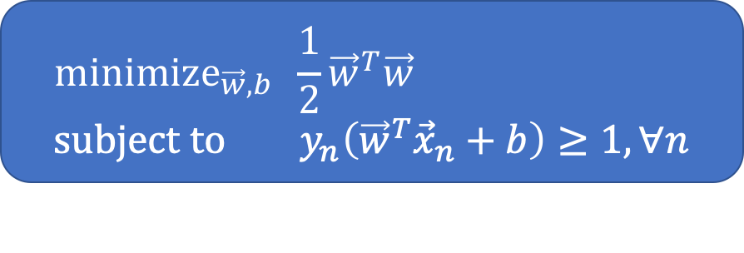
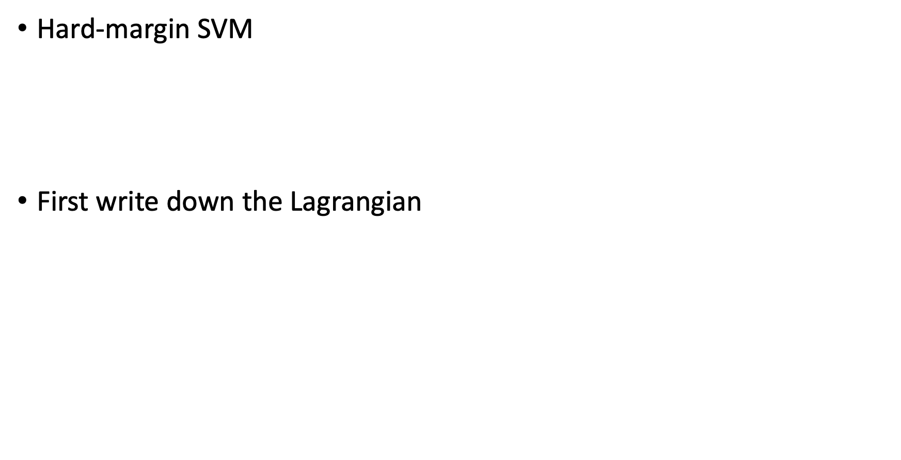
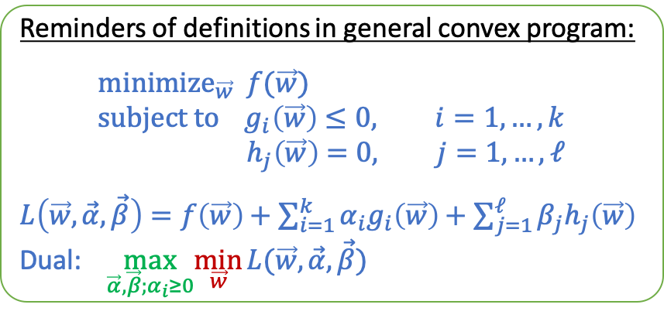
Derive the Dual for Hard-Margin SVM
Reminders of definitions in general convex program:
$${\text{minimize}}_{\vec{w}} f(\vec{w}) \\ \text{subject} \text{to} g_{i}\left(\vec{w}\right)≤0, i=1,…,k \\ h_{j}\left(\vec{w}\right)=0, j=1,…,ℓ$$
$L\left(\vec{w},\vec{α},\vec{β}\right)=f\left(\vec{w}\right)+\sum_{i=1}^{k}{α_{i}g_{i}\left(\vec{w}\right)+\sum_{j=1}^{ℓ}{β_{j}h_{j}\left(\vec{w}\right)}}$
Dual: $\max_{\vec{α},\vec{β};α_{i}≥0}\min_{\vec{w}}{L(\vec{w},\vec{α},\vec{β})}$
Hard-margin SVM
First write down the Lagrangian
$L\left(\vec{w},b,\vec{α}\right)=\frac{1}{2}{\vec{w}}^{T}\vec{w}+\sum_{n=1}^{N}{α_{n}\left(1−y_{n}\left({\vec{w}}^{T}{\vec{x}}_{n}+b\right)\right)}$
$=\frac{1}{2}{\vec{w}}^{T}\vec{w}+\sum_{n=1}^{N}{α_{n}}−\sum_{n=1}^{N}{α_{n}y_{n}\left({\vec{w}}^{T}{\vec{x}}_{n}+b\right)}$
Dual
$\max_{\vec{α};α_{i}≥0}{\min_{\vec{w},b}{L(\vec{w},b,\vec{α})}}$
$${\text{minimize}}_{\vec{w},b} \frac{1}{2}{\vec{w}}^{T}\vec{w} \\ \text{subject} \text{to} y_{n}\left({\vec{w}}^{T}{\vec{x}}_{n}+b\right)≥1, ∀n$$

Slide 21
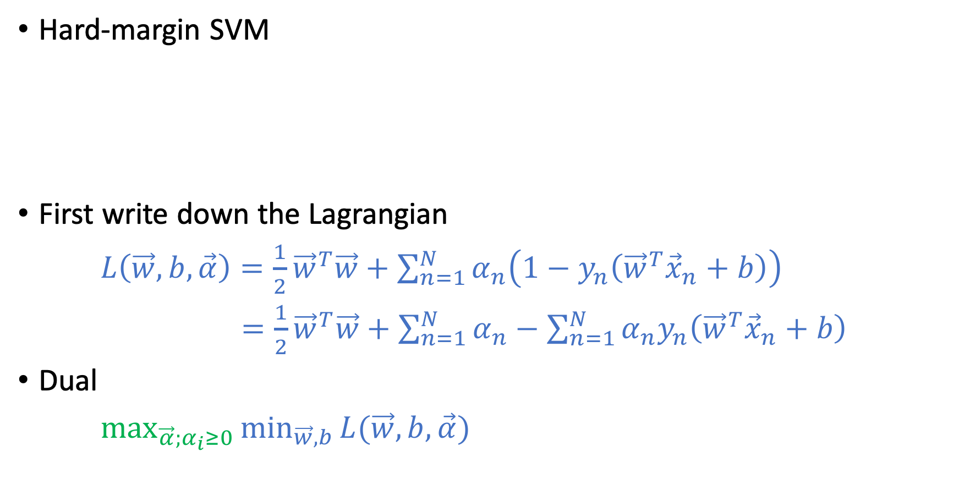
Derive the Dual for Hard-Margin SVM
Reminders of definitions in general convex program:
$${\text{minimize}}_{\vec{w}} f(\vec{w}) \\ \text{subject} \text{to} g_{i}\left(\vec{w}\right)≤0, i=1,…,k \\ h_{j}\left(\vec{w}\right)=0, j=1,…,ℓ$$
$L\left(\vec{w},\vec{α},\vec{β}\right)=f\left(\vec{w}\right)+\sum_{i=1}^{k}{α_{i}g_{i}\left(\vec{w}\right)+\sum_{j=1}^{ℓ}{β_{j}h_{j}\left(\vec{w}\right)}}$
Dual: $\max_{\vec{α},\vec{β};α_{i}≥0}\min_{\vec{w}}{L(\vec{w},\vec{α},\vec{β})}$
Hard-margin SVM
First write down the Lagrangian
$L\left(\vec{w},b,\vec{α}\right)=\frac{1}{2}{\vec{w}}^{T}\vec{w}+\sum_{n=1}^{N}{α_{n}\left(1−y_{n}\left({\vec{w}}^{T}{\vec{x}}_{n}+b\right)\right)}$
$=\frac{1}{2}{\vec{w}}^{T}\vec{w}+\sum_{n=1}^{N}{α_{n}}−\sum_{n=1}^{N}{α_{n}y_{n}\left({\vec{w}}^{T}{\vec{x}}_{n}+b\right)}$
Dual
$\max_{\vec{α};α_{i}≥0}{\min_{\vec{w},b}{L(\vec{w},b,\vec{α})}}$
$${\text{minimize}}_{\vec{w},b} \frac{1}{2}{\vec{w}}^{T}\vec{w} \\ \text{subject} \text{to} y_{n}\left({\vec{w}}^{T}{\vec{x}}_{n}+b\right)≥1, ∀n$$

Slide 22
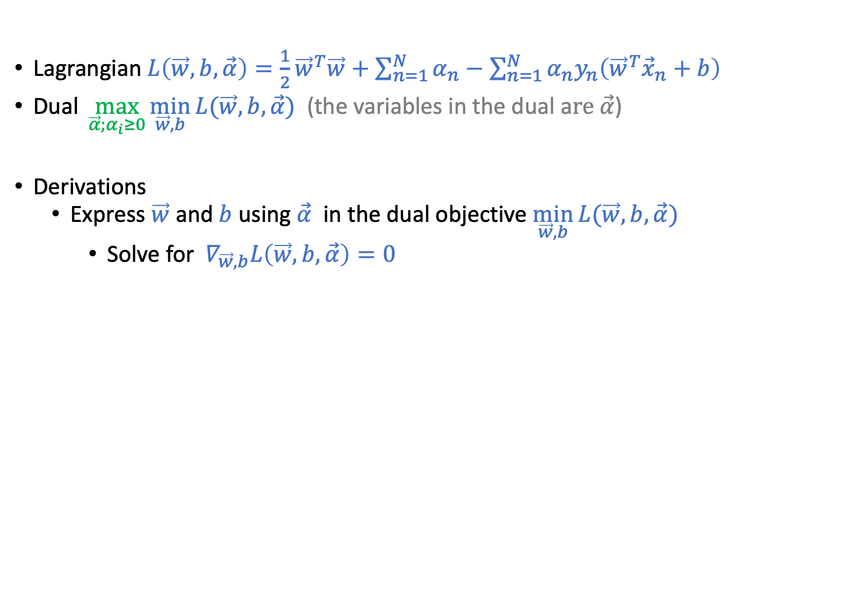
Lagrangian $L\left(\vec{w},b,\vec{α}\right)=\frac{1}{2}{\vec{w}}^{T}\vec{w}+\sum_{n=1}^{N}{α_{n}}−\sum_{n=1}^{N}{α_{n}y_{n}\left({\vec{w}}^{T}{\vec{x}}_{n}+b\right)}$
Dual $\max_{\vec{α};α_{i}≥0}{\min_{\vec{w},b}{L(\vec{w},b,\vec{α})}}$ (the variables in the dual a$re \vec{α}$)
Derivations
Express $\vec{w}$ and $b$ using $\vec{α}$ in the dual objective $\min_{\vec{w},b}{L(\vec{w},b,\vec{α})}$
Solve for $∇_{\vec{w},b}L\left(\vec{w},b,\vec{α}\right)=0$
$∇_{\vec{w}}L\left(\vec{w},b,\vec{α}\right)=0$ => $\vec{w}−$ $\sum_{n=1}^{N}{α_{n}y_{n}{\vec{x}}_{n}}=0$ => $\vec{w}=\sum_{n=1}^{N}{α_{n}y_{n}{\vec{x}}_{n}}$
$∇_{b}L\left(\vec{w},b,\vec{α}\right)=0$ => $\sum_{n=1}^{N}{α_{n}y_{n}=0}$
Plug $\vec{w}=\sum_{n=1}^{N}{α_{n}y_{n}{\vec{x}}_{n}}$ into $L(\vec{w},b,\vec{α})$
$\frac{1}{2}{\vec{w}}^{T}\vec{w}=\frac{1}{2}\sum_{n=1}^{N}{\sum_{m=1}^{N}{α_{n}α_{m}y_{n}y_{m}{\vec{x}}_{n}^{T}{\vec{x}}_{m}}}$
$\sum_{n=1}^{N}{α_{n}y_{n}\left({\vec{w}}^{T}\vec{x}+b\right)=}$ $\sum_{n=1}^{N}{\sum_{m=1}^{N}{α_{n}α_{m}y_{n}y_{m}{\vec{x}}_{n}^{T}{\vec{x}}_{m}}}+b\sum_{n=1}^{N}{α_{n}y_{n}}$
$\min_{\vec{w},b}{L\left(\vec{w},b,\vec{α}\right)=}$ $\sum_{n=1}^{N}{α_{n}}−\frac{1}{2}\sum_{n=1}^{N}{\sum_{m=1}^{N}{α_{n}α_{m}y_{n}y_{m}{\vec{x}}_{n}^{T}{\vec{x}}_{m}}}$

Slide 23
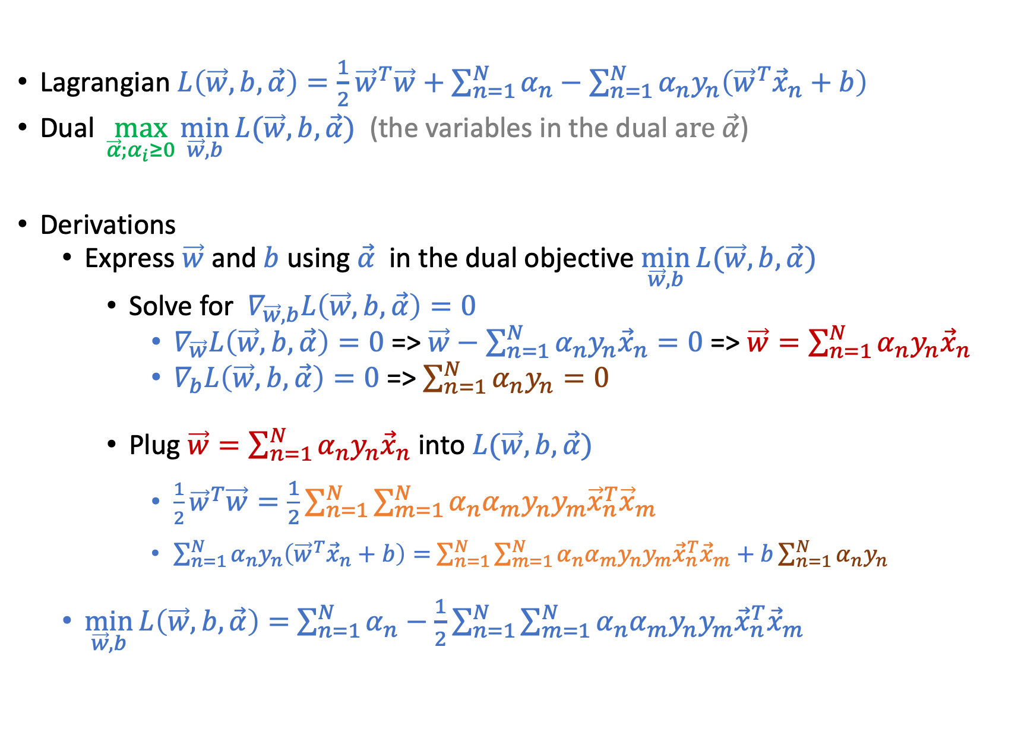
Lagrangian $L\left(\vec{w},b,\vec{α}\right)=\frac{1}{2}{\vec{w}}^{T}\vec{w}+\sum_{n=1}^{N}{α_{n}}−\sum_{n=1}^{N}{α_{n}y_{n}\left({\vec{w}}^{T}{\vec{x}}_{n}+b\right)}$
Dual $\max_{\vec{α};α_{i}≥0}{\min_{\vec{w},b}{L(\vec{w},b,\vec{α})}}$ (the variables in the dual a$re \vec{α}$)
Derivations
Express $\vec{w}$ and $b$ using $\vec{α}$ in the dual objective $\min_{\vec{w},b}{L(\vec{w},b,\vec{α})}$
Solve for $∇_{\vec{w},b}L\left(\vec{w},b,\vec{α}\right)=0$
$∇_{\vec{w}}L\left(\vec{w},b,\vec{α}\right)=0$ => $\vec{w}−$ $\sum_{n=1}^{N}{α_{n}y_{n}{\vec{x}}_{n}}=0$ => $\vec{w}=\sum_{n=1}^{N}{α_{n}y_{n}{\vec{x}}_{n}}$
$∇_{b}L\left(\vec{w},b,\vec{α}\right)=0$ => $\sum_{n=1}^{N}{α_{n}y_{n}=0}$
Plug $\vec{w}=\sum_{n=1}^{N}{α_{n}y_{n}{\vec{x}}_{n}}$ into $L(\vec{w},b,\vec{α})$
$\frac{1}{2}{\vec{w}}^{T}\vec{w}=\frac{1}{2}\sum_{n=1}^{N}{\sum_{m=1}^{N}{α_{n}α_{m}y_{n}y_{m}{\vec{x}}_{n}^{T}{\vec{x}}_{m}}}$
$\sum_{n=1}^{N}{α_{n}y_{n}\left({\vec{w}}^{T}{\vec{x}}_{n}+b\right)=}$ $\sum_{n=1}^{N}{\sum_{m=1}^{N}{α_{n}α_{m}y_{n}y_{m}{\vec{x}}_{n}^{T}{\vec{x}}_{m}}}+b\sum_{n=1}^{N}{α_{n}y_{n}}$
$\min_{\vec{w},b}{L\left(\vec{w},b,\vec{α}\right)=}$ $\sum_{n=1}^{N}{α_{n}}−\frac{1}{2}\sum_{n=1}^{N}{\sum_{m=1}^{N}{α_{n}α_{m}y_{n}y_{m}{\vec{x}}_{n}^{T}{\vec{x}}_{m}}}$

Slide 24
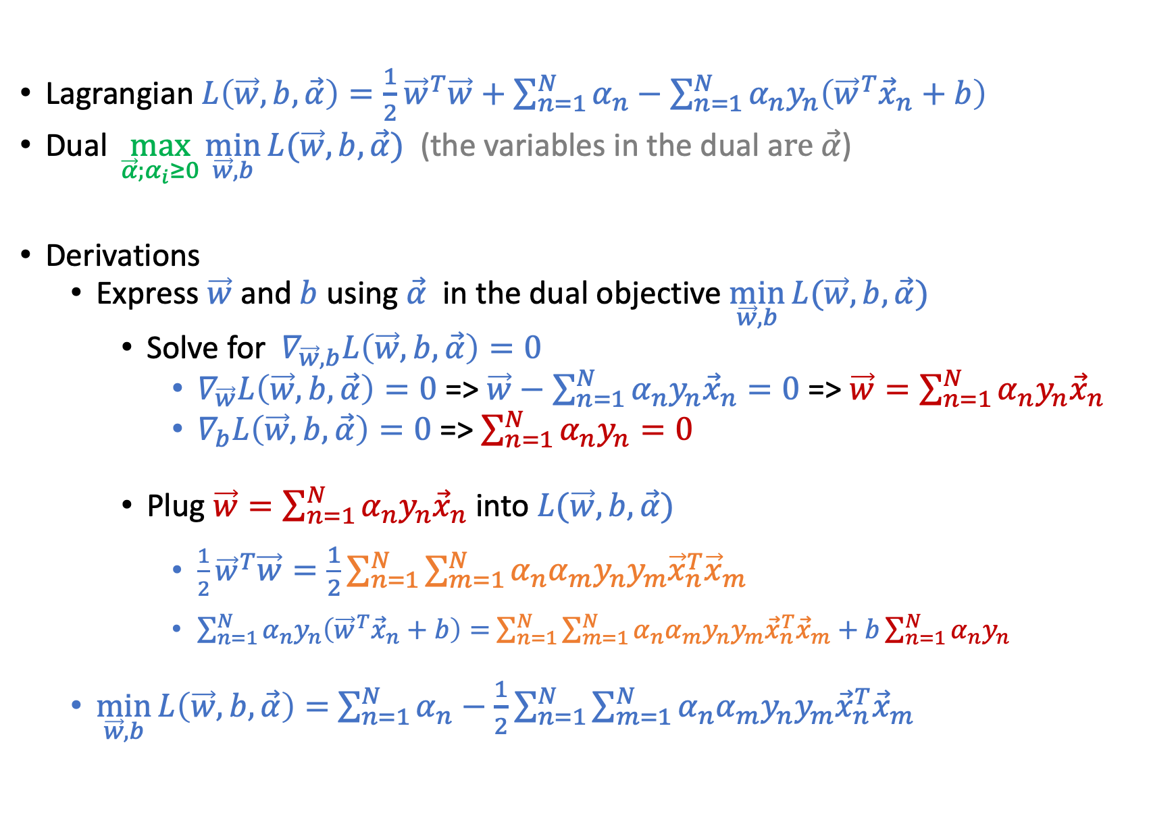
Lagrangian $L\left(\vec{w},b,\vec{α}\right)=\frac{1}{2}{\vec{w}}^{T}\vec{w}+\sum_{n=1}^{N}{α_{n}}−\sum_{n=1}^{N}{α_{n}y_{n}\left({\vec{w}}^{T}{\vec{x}}_{n}+b\right)}$
Dual $\max_{\vec{α};α_{i}≥0}{\min_{\vec{w},b}{L(\vec{w},b,\vec{α})}}$ (the variables in the dual a$re \vec{α}$)
Derivations
Express $\vec{w}$ and $b$ using $\vec{α}$ in the dual objective $\min_{\vec{w},b}{L(\vec{w},b,\vec{α})}$
Solve for $∇_{\vec{w},b}L\left(\vec{w},b,\vec{α}\right)=0$
$∇_{\vec{w}}L\left(\vec{w},b,\vec{α}\right)=0$ => $\vec{w}−$ $\sum_{n=1}^{N}{α_{n}y_{n}{\vec{x}}_{n}}=0$ => $\vec{w}=\sum_{n=1}^{N}{α_{n}y_{n}{\vec{x}}_{n}}$
$∇_{b}L\left(\vec{w},b,\vec{α}\right)=0$ => $\sum_{n=1}^{N}{α_{n}y_{n}=0}$
Plug $\vec{w}=\sum_{n=1}^{N}{α_{n}y_{n}{\vec{x}}_{n}}$ into $L(\vec{w},b,\vec{α})$
$\frac{1}{2}{\vec{w}}^{T}\vec{w}=\frac{1}{2}\sum_{n=1}^{N}{\sum_{m=1}^{N}{α_{n}α_{m}y_{n}y_{m}{\vec{x}}_{n}^{T}{\vec{x}}_{m}}}$
$\sum_{n=1}^{N}{α_{n}y_{n}\left({\vec{w}}^{T}{\vec{x}}_{n}+b\right)=}$ $\sum_{n=1}^{N}{\sum_{m=1}^{N}{α_{n}α_{m}y_{n}y_{m}{\vec{x}}_{n}^{T}{\vec{x}}_{m}}}+b\sum_{n=1}^{N}{α_{n}y_{n}}$
$\min_{\vec{w},b}{L\left(\vec{w},b,\vec{α}\right)=}$ $\sum_{n=1}^{N}{α_{n}}−\frac{1}{2}\sum_{n=1}^{N}{\sum_{m=1}^{N}{α_{n}α_{m}y_{n}y_{m}{\vec{x}}_{n}^{T}{\vec{x}}_{m}}}$
Dual Constraint
Dual Constraint
Dual Objective

Slide 25
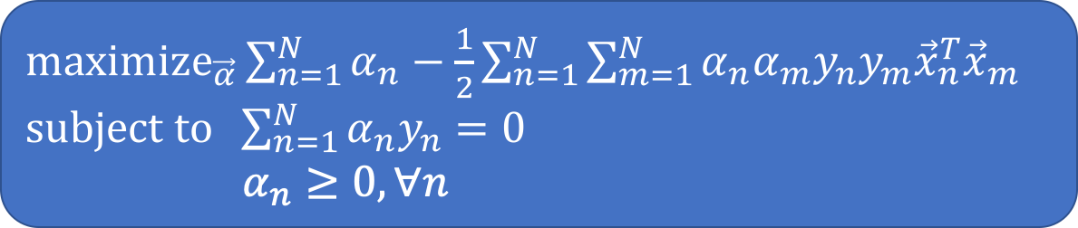
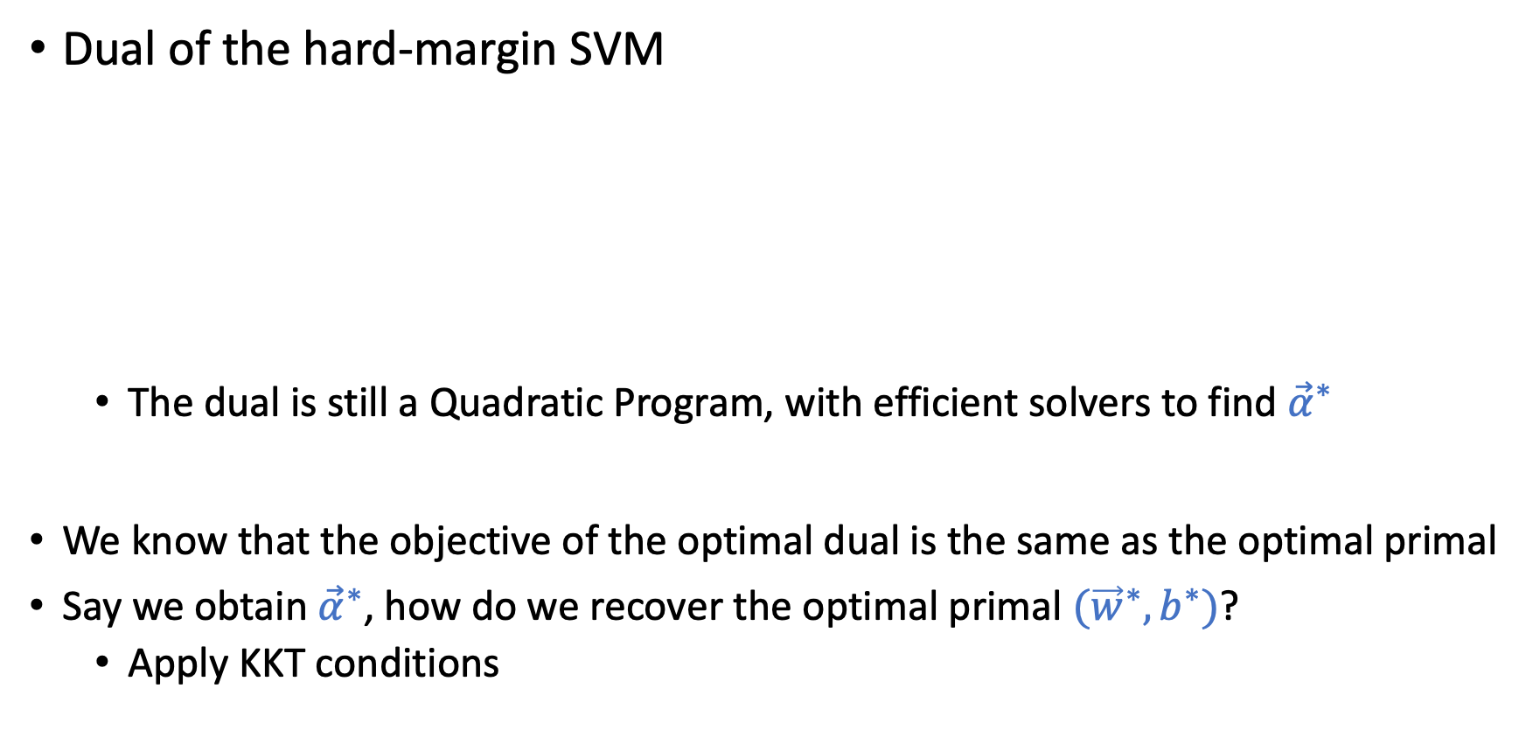
Dual SVM
Dual of the hard-margin SVM
The dual is still a Quadratic Program, with efficient solvers to find ${\vec{α}}^{∗}$
We know that the objective of the optimal dual is the same as the optimal primal
Say we obtain ${\vec{α}}^{∗}$, how do we recover the optimal primal $({\vec{w}}^{∗},b^{∗})$?
Apply KKT conditions
${\text{maximize}}_{\vec{α}}\sum_{n=1}^{N}{α_{n}}−\frac{1}{2}\sum_{n=1}^{N}{\sum_{m=1}^{N}{α_{n}α_{m}y_{n}y_{m}{\vec{x}}_{n}^{T}{\vec{x}}_{m}}}$ $\text{subject} \text{to} \sum_{n=1}^{N}{α_{n}y_{n}=0}$
$α_{n}≥0,∀n$

Slide 26
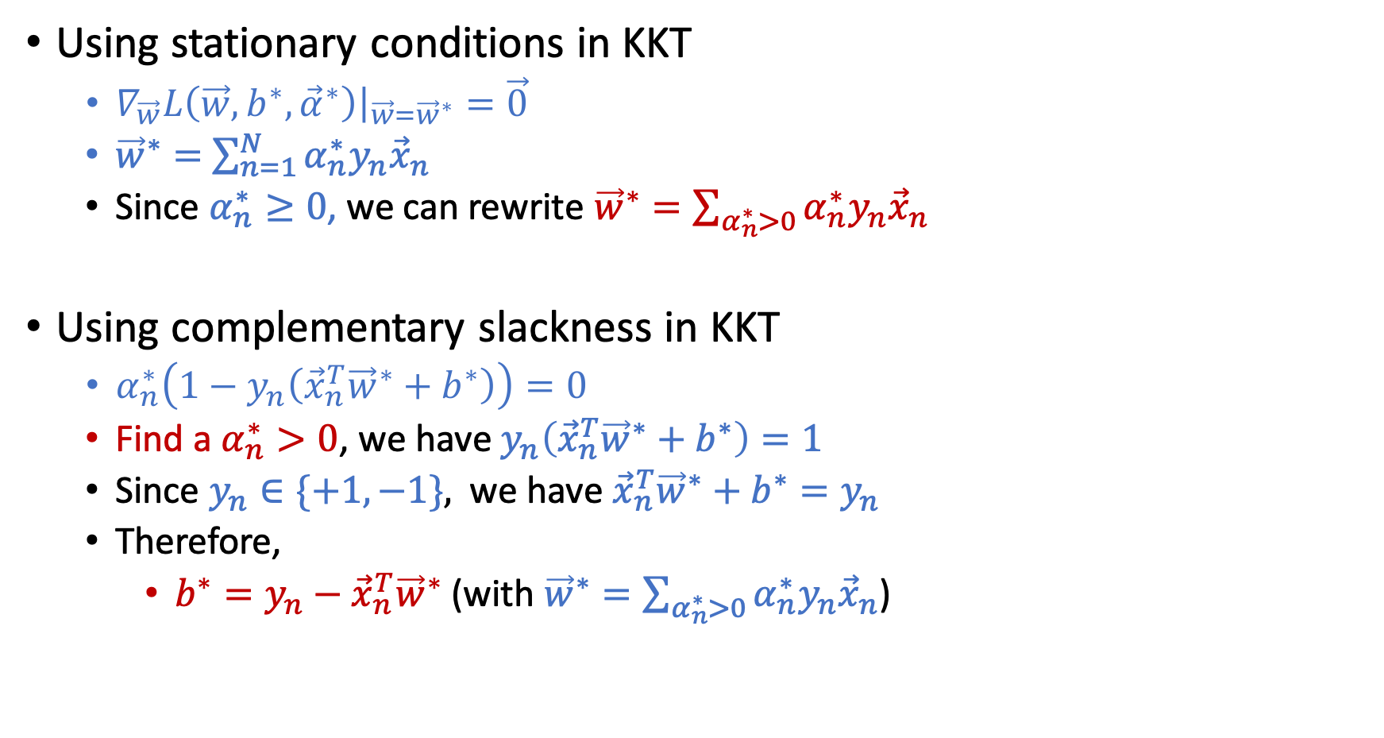

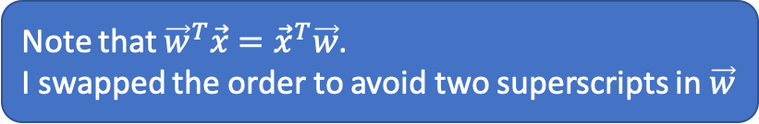
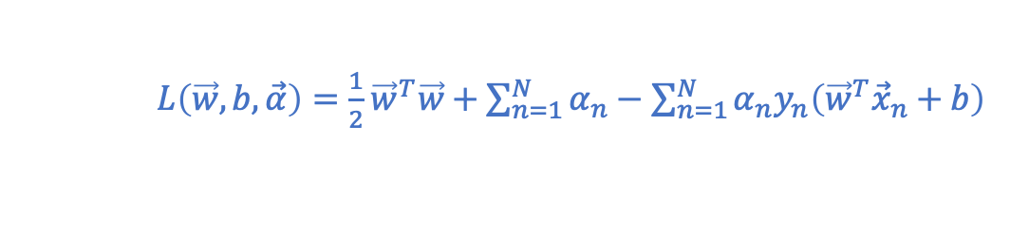
Recover $({\vec{w}}^{∗},b^{∗})$ from ${\vec{α}}^{∗}$
Using stationary conditions in KKT
$∇_{\vec{w}}L\left(\vec{w},b^{∗},{\vec{α}}^{∗}\right){\left.​\right|}_{\vec{w}={\vec{w}}^{∗}}=\vec{0}$
${\vec{w}}^{∗}=$ $\sum_{n=1}^{N}{α_{n}^{∗}y_{n}{\vec{x}}_{n}}$
Since $α_{n}^{∗}≥0$, we can rewrite ${\vec{w}}^{∗}=\sum_{α_{n}^{∗}>0}{α_{n}^{∗}y_{n}{\vec{x}}_{n}}$
Using complementary slackness in KKT
$α_{n}^{∗}\left(1−y_{n}\left({\vec{x}}_{n}^{T}{\vec{w}}^{∗}+b^{∗}\right)\right)=0$
Find a $α_{n}^{∗}>0$, we have $y_{n}\left({\vec{x}}_{n}^{T}{\vec{w}}^{∗}+b^{∗}\right)=1$
Since $y_{n}∈\{+1,−1\},$ we have ${\vec{x}}_{n}^{T}{\vec{w}}^{∗}+b^{∗}=y_{n}$
Therefore,
$b^{∗}=y_{n}−{\vec{x}}_{n}^{T}{\vec{w}}^{∗}$ (with ${\vec{w}}^{∗}=\sum_{α_{n}^{∗}>0}{α_{n}^{∗}y_{n}{\vec{x}}_{n}}$)
$L\left(\vec{w},b,\vec{α}\right)=\frac{1}{2}{\vec{w}}^{T}\vec{w}+\sum_{n=1}^{N}{α_{n}}−\sum_{n=1}^{N}{α_{n}y_{n}\left({\vec{w}}^{T}{\vec{x}}_{n}+b\right)}$
Note that ${\vec{w}}^{T}\vec{x}={\vec{x}}^{T}\vec{w}$. I swapped the order to avoid two superscripts in $\vec{w}$

Slide 27
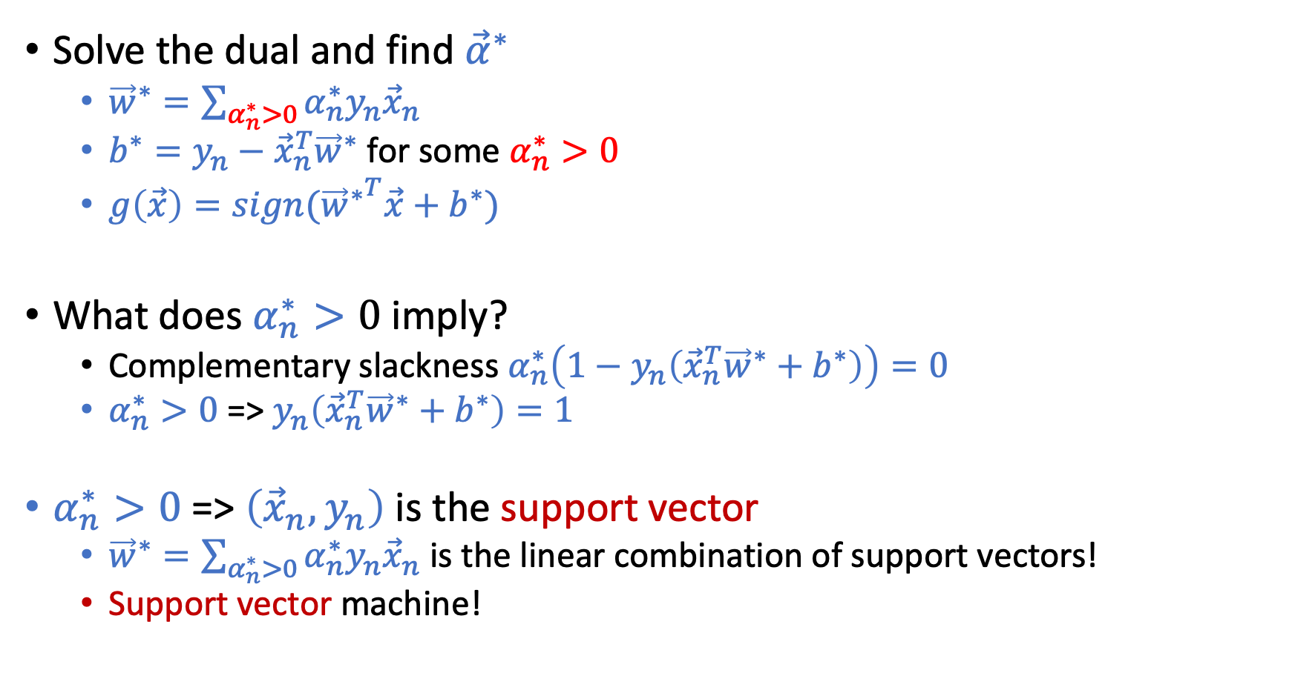

Recover $({\vec{w}}^{∗},b^{∗})$ from ${\vec{α}}^{∗}$
Solve the dual and find ${\vec{α}}^{∗}$
${\vec{w}}^{∗}=\sum_{α_{n}^{∗}>0}{α_{n}^{∗}y_{n}{\vec{x}}_{n}}$
$b^{∗}=y_{n}−{\vec{x}}_{n}^{T}{\vec{w}}^{∗}$ for some $α_{n}^{∗}>0$
$g\left(\vec{x}\right)=sign({{\vec{w}}^{∗}}^{T}\vec{x}+b^{∗})$
What does $α_{n}^{∗}>0$ imply?
Complementary slackness $α_{n}^{∗}\left(1−y_{n}\left({\vec{x}}_{n}^{T}{\vec{w}}^{∗}+b^{∗}\right)\right)=0$
$α_{n}^{∗}>0$ => $y_{n}\left({\vec{x}}_{n}^{T}{\vec{w}}^{∗}+b^{∗}\right)=1$
$α_{n}^{∗}>0$ => $\left({\vec{x}}_{n},y_{n}\right)$ is the support vector
${\vec{w}}^{∗}=\sum_{α_{n}^{∗}>0}{α_{n}^{∗}y_{n}{\vec{x}}_{n}}$ is the linear combination of support vectors!
Support vector machine!

Slide 28
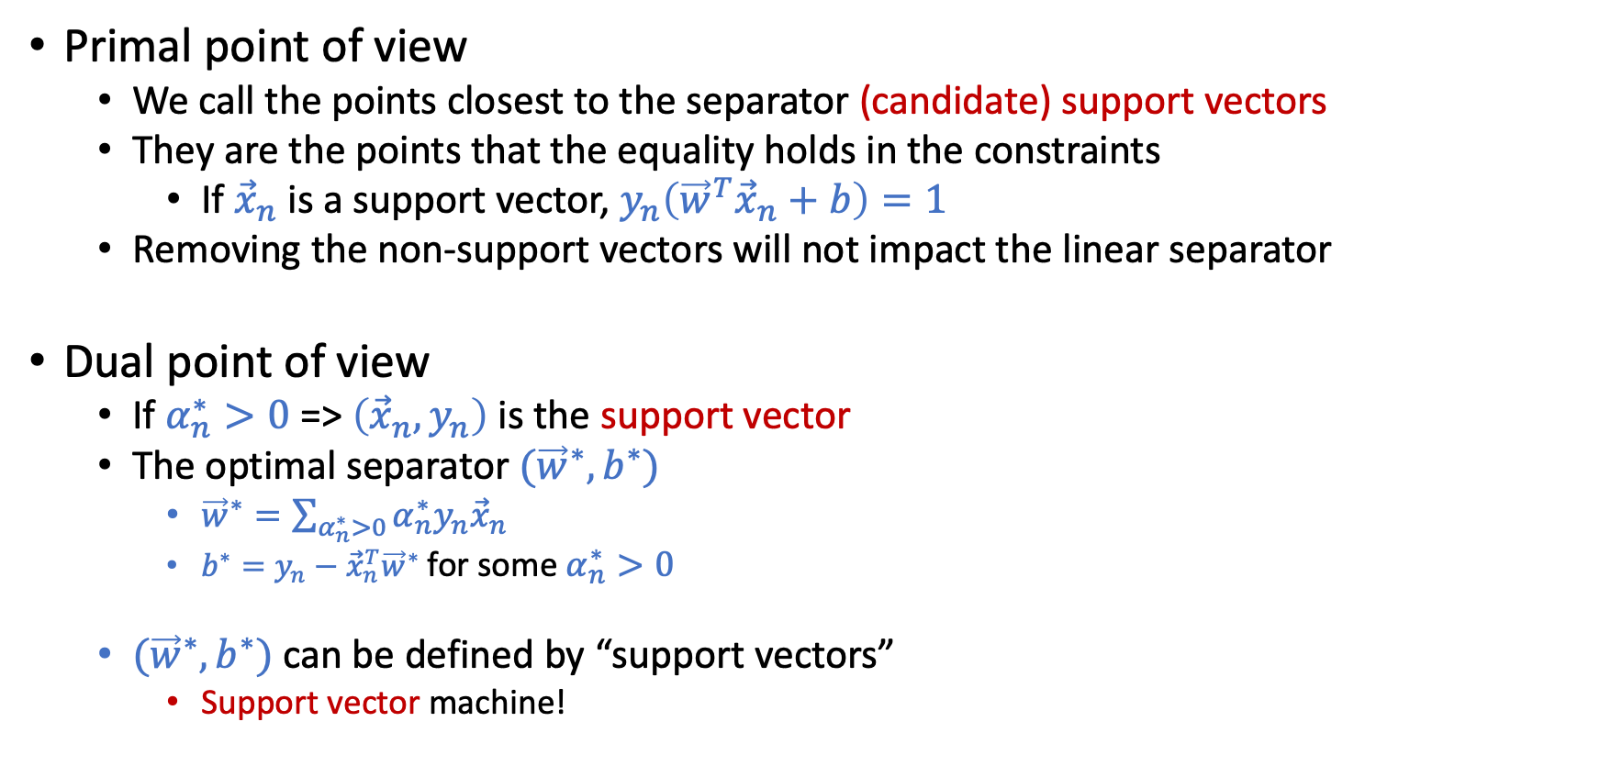
Support Vectors
Primal point of view
We call the points closest to the separator (candidate) support vectors
They are the points that the equality holds in the constraints
If ${\vec{x}}_{n}$ is a support vector, $y_{n}\left({\vec{w}}^{T}{\vec{x}}_{n}+b\right)=1$
Removing the non-support vectors will not impact the linear separator
Dual point of view
If $α_{n}^{∗}>0$ => $\left({\vec{x}}_{n},y_{n}\right)$ is the support vector
The optimal separator $({\vec{w}}^{∗},b^{∗})$
${\vec{w}}^{∗}=\sum_{α_{n}^{∗}>0}{α_{n}^{∗}y_{n}{\vec{x}}_{n}}$
$b^{∗}=y_{n}−{\vec{x}}_{n}^{T}{\vec{w}}^{∗}$for some $α_{n}^{∗}>0$
$({\vec{w}}^{∗},b^{∗})$ can be defined by “support vectors”
Support vector machine!

Slide 29
Nonlinear Transform and Kernel Tricks

Slide 30
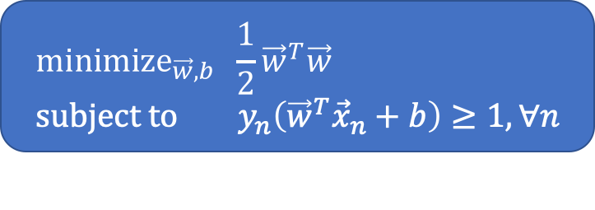
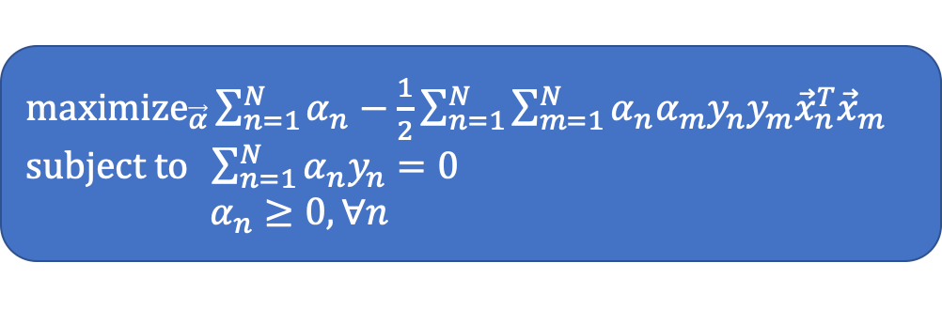
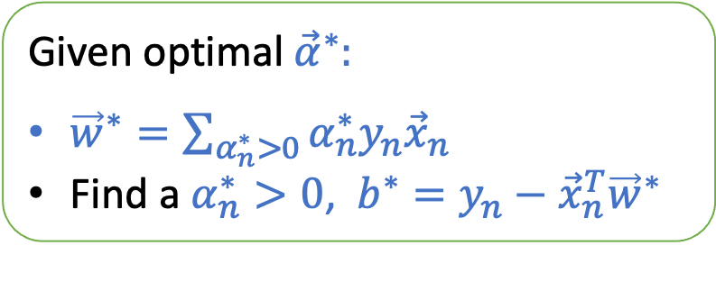
Primal-Dual Formulations of Hard-Margin SVM
Primal
Dual
Both can be efficiently solved using QP solvers
We can infer the solution from one to the other
Given optimal ${\vec{α}}^{∗}:$
${\vec{w}}^{∗}=\sum_{α_{n}^{∗}>0}{α_{n}^{∗}y_{n}{\vec{x}}_{n}}$
Find a $α_{n}^{∗}>0$, $b^{∗}=y_{n}−{\vec{x}}_{n}^{T}{\vec{w}}^{∗}$
$${\text{minimize}}_{\vec{w},b} \frac{1}{2}{\vec{w}}^{T}\vec{w} \\ \text{subject} \text{to} y_{n}\left({\vec{w}}^{T}{\vec{x}}_{n}+b\right)≥1, ∀n$$
${\text{maximize}}_{\vec{α}}\sum_{n=1}^{N}{α_{n}}−\frac{1}{2}\sum_{n=1}^{N}{\sum_{m=1}^{N}{α_{n}α_{m}y_{n}y_{m}{\vec{x}}_{n}^{T}{\vec{x}}_{m}}}$ $\text{subject} \text{to} \sum_{n=1}^{N}{α_{n}y_{n}=0}$ $α_{n}≥0,∀n$

Slide 31
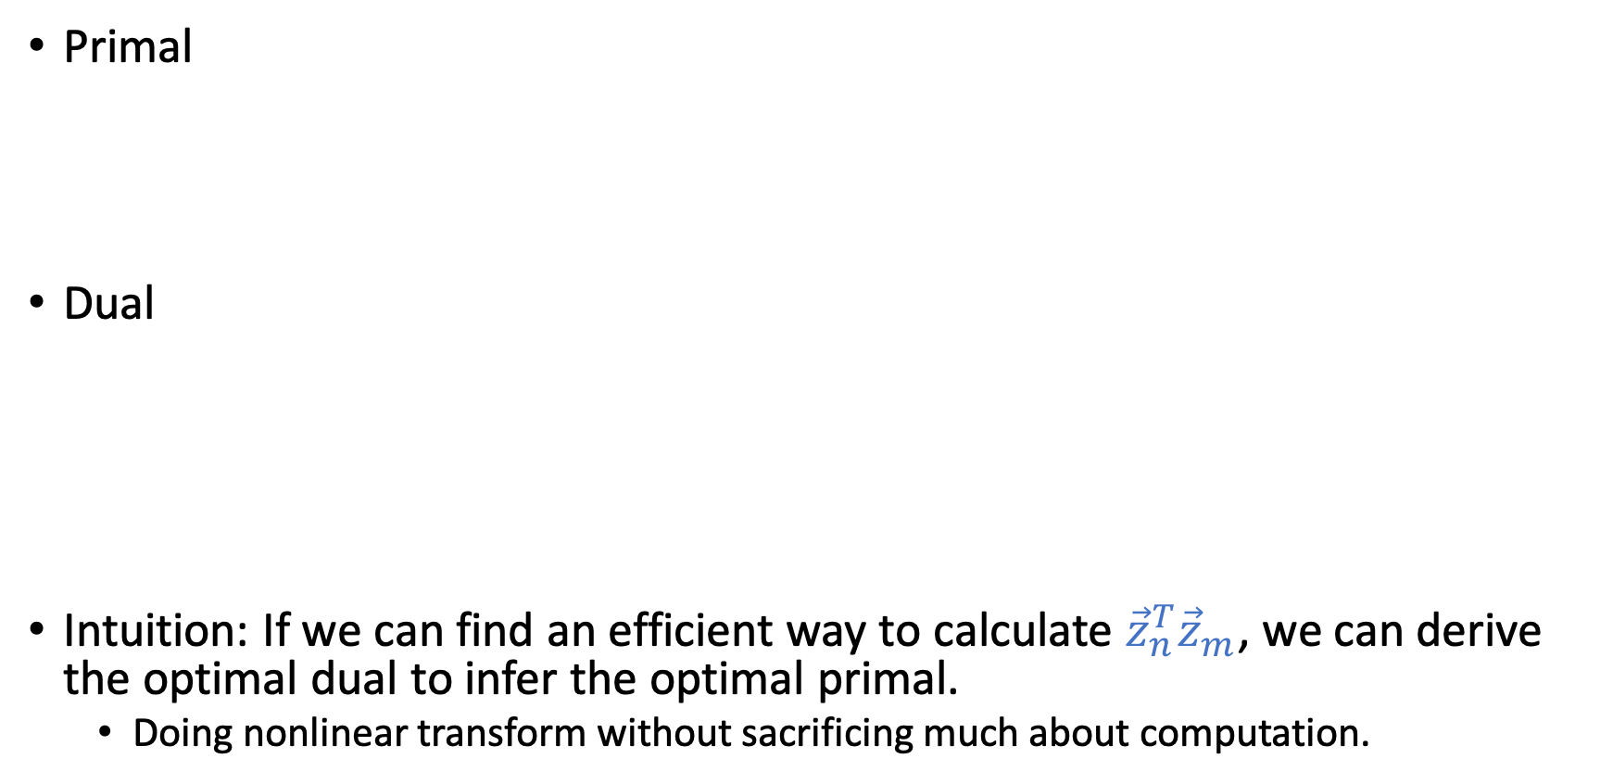
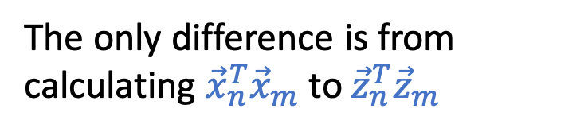

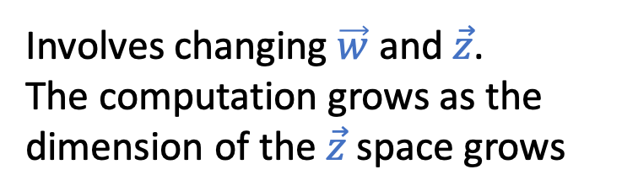
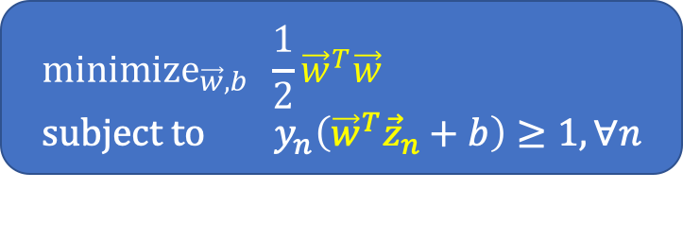
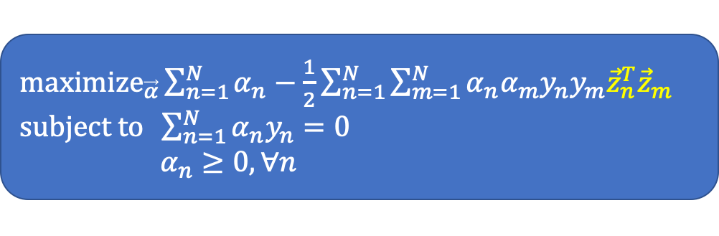
Nonlinear Transform: $\vec{z}=Φ(\vec{x})$
Primal
Dual
Intuition: If we can find an efficient way to calculate ${\vec{z}}_{n}^{T}{\vec{z}}_{m}$, we can derive the optimal dual to infer the optimal primal.
Doing nonlinear transform without sacrificing much about computation.
$${\text{minimize}}_{\vec{w},b} \frac{1}{2}{\vec{w}}^{T}\vec{w} \\ \text{subject} \text{to} y_{n}\left({\vec{w}}^{T}{\vec{z}}_{n}+b\right)≥1, ∀n$$
Involves changing $\vec{w}$ and $\vec{z}$.
The computation grows as the dimension of the $\vec{z}$ space grows
${\text{maximize}}_{\vec{α}}\sum_{n=1}^{N}{α_{n}}−\frac{1}{2}\sum_{n=1}^{N}{\sum_{m=1}^{N}{α_{n}α_{m}y_{n}y_{m}{\vec{z}}_{n}^{T}{\vec{z}}_{m}}}$ $\text{subject} \text{to} \sum_{n=1}^{N}{α_{n}y_{n}=0}$ $α_{n}≥0,∀n$
The only difference is from calculating ${\vec{x}}_{n}^{T}{\vec{x}}_{m}$ to ${\vec{z}}_{n}^{T}{\vec{z}}_{m}$

Slide 32
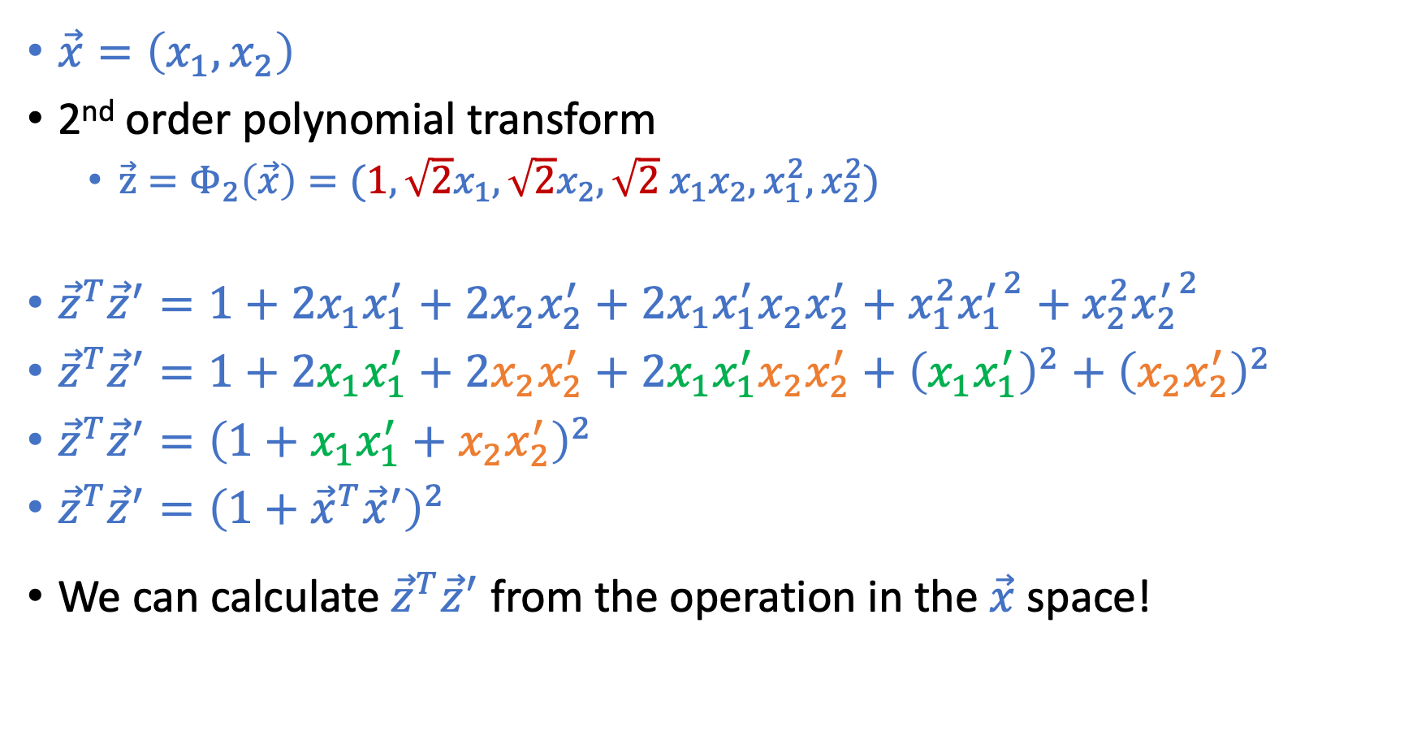
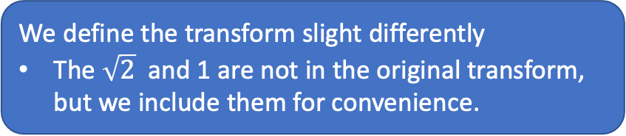
Example: 2nd Order Polynomial Transform
We define the transform slight differently
The $\sqrt{2}$ and 1 are not in the original transform, but we include them for convenience.
$\vec{x}=\left(x_{1},x_{2}\right)$
2nd order polynomial transform
${\vec{z}=Φ}_{2}\left(\vec{x}\right)=({1,\sqrt{2}x}_{1},{\sqrt{2}x}_{2},\sqrt{2}{ x}_{1}x_{2},x_{1}^{2},x_{2}^{2})$
${\vec{z}}^{T}{\vec{z}}^{′}=1+2x_{1}x_{1}^{′}+2x_{2}x_{2}^{′}+2x_{1}x_{1}^{′}x_{2}x_{2}^{′}+x_{1}^{2}{x_{1}^{′}}^{2}+x_{2}^{2}{x_{2}^{′}}^{2}$
${\vec{z}}^{T}{\vec{z}}^{′}=1+2x_{1}x_{1}^{′}+2x_{2}x_{2}^{′}+2x_{1}x_{1}^{′}x_{2}x_{2}^{′}+{\left(x_{1}x_{1}^{′}\right)}^{2}+{\left(x_{2}x_{2}^{′}\right)}^{2}$
${\vec{z}}^{T}{\vec{z}}^{′}={\left(1+x_{1}x_{1}^{′}+x_{2}x_{2}^{′}\right)}^{2}$
${\vec{z}}^{T}{\vec{z}}^{′}={\left(1+{\vec{x}}^{T}{\vec{x}}^{′}\right)}^{2}$
We can calculate ${\vec{z}}^{T}{\vec{z}}^{′}$ from the operation in the $\vec{x}$ space!

Slide 33
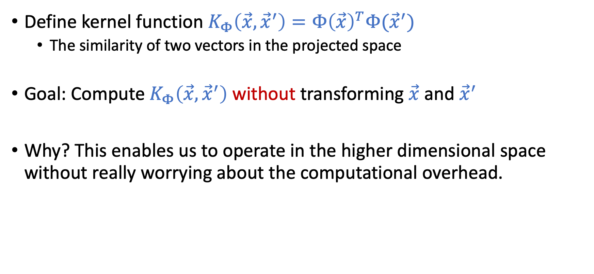
Kernel Functions
Define kernel function $K_{Φ}\left(\vec{x},{\vec{x}}^{′}\right)=Φ{\left(\vec{x}\right)}^{T}Φ({\vec{x}}^{′})$
The similarity of two vectors in the projected space
Goal: Compute $K_{Φ}\left(\vec{x},{\vec{x}}^{′}\right)$ without transforming $\vec{x}$ and ${\vec{x}}^{′}$
Why? This enables us to operate in the higher dimensional space without really worrying about the computational overhead.

Slide 34
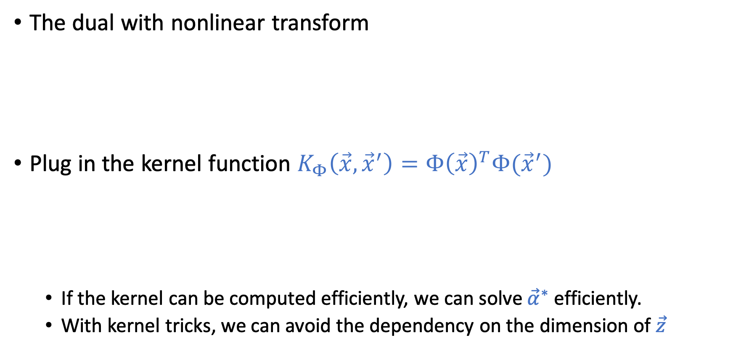
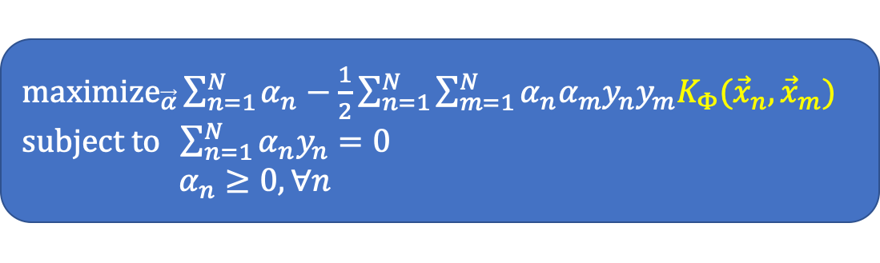
Kernel Trick: Utilize Dual and Kernel Functions
The dual with nonlinear transform
Plug in the kernel function $K_{Φ}\left(\vec{x},{\vec{x}}^{′}\right)=Φ{\left(\vec{x}\right)}^{T}Φ({\vec{x}}^{′})$
If the kernel can be computed efficiently, we can solve ${\vec{α}}^{∗}$ efficiently.
With kernel tricks, we can avoid the dependency on the dimension of $\vec{z}$
${\text{maximize}}_{\vec{α}}\sum_{n=1}^{N}{α_{n}}−\frac{1}{2}\sum_{n=1}^{N}{\sum_{m=1}^{N}{α_{n}α_{m}y_{n}y_{m}{\vec{z}}_{n}^{T}{\vec{z}}_{m}}}$ $\text{subject} \text{to} \sum_{n=1}^{N}{α_{n}y_{n}=0}$ $α_{n}≥0,∀n$
${\text{maximize}}_{\vec{α}}\sum_{n=1}^{N}{α_{n}}−\frac{1}{2}\sum_{n=1}^{N}{\sum_{m=1}^{N}{α_{n}α_{m}y_{n}y_{m}K_{Φ}({\vec{x}}_{n},{\vec{x}}_{m})}}$ $\text{subject} \text{to} \sum_{n=1}^{N}{α_{n}y_{n}=0}$ $α_{n}≥0,∀n$

Slide 35
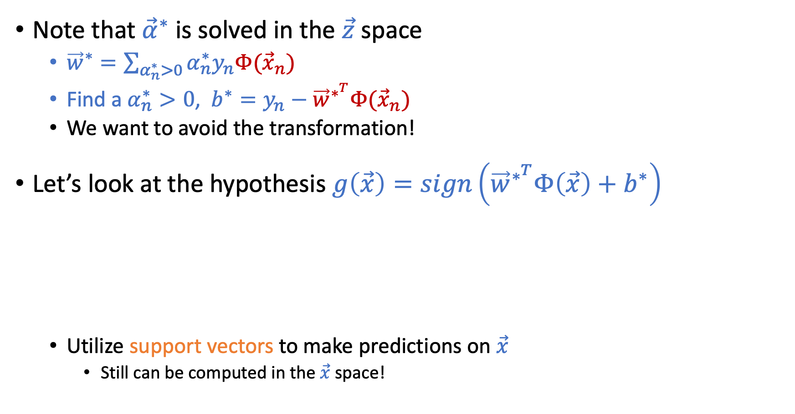

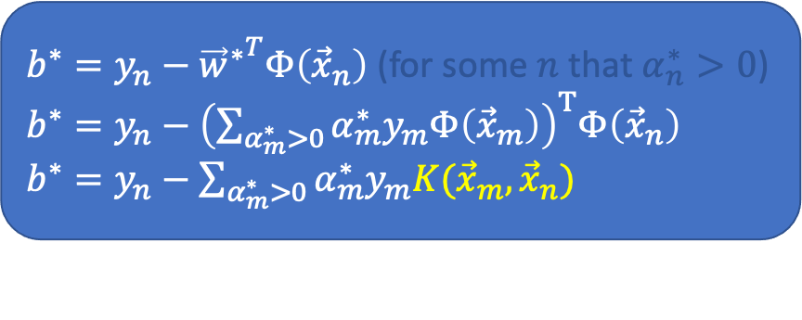

Recover $({\vec{w}}^{∗},b^{∗})$ from ${\vec{α}}^{∗}$ with Kernel Tricks
Note that ${\vec{α}}^{∗}$ is solved in the $\vec{z}$ space
${\vec{w}}^{∗}=\sum_{α_{n}^{∗}>0}{α_{n}^{∗}y_{n}Φ({\vec{x}}_{n})}$
Find a $α_{n}^{∗}>0$, $b^{∗}=y_{n}−{\vec{w}}^{∗^{T}}Φ({\vec{x}}_{n})$
We want to avoid the transformation!
Let’s look at the hypothesis $g\left(\vec{x}\right)=sign\left({\vec{w}}^{∗^{T}}Φ\left(\vec{x}\right)+b^{∗}\right)$
Utilize support vectors to make predictions on $\vec{x}$
Still can be computed in the $\vec{x}$ space!
${{\vec{w}}^{∗}}^{T}Φ\left(\vec{x}\right)={\left(\sum_{α_{n}^{∗}>0}{α_{n}^{∗}y_{n}Φ\left({\vec{x}}_{n}\right)}\right)}^{T}Φ(\vec{x})$
${{\vec{w}}^{∗}}^{T}Φ\left(\vec{x}\right)={\sum_{α_{n}^{∗}>0}{α_{n}^{∗}y_{n}Φ\left({\vec{x}}_{n}\right)}}^{T}Φ(\vec{x})$
${{\vec{w}}^{∗}}^{T}Φ\left(\vec{x}\right)={\sum_{α_{n}^{∗}>0}{α_{n}^{∗}y_{n}K({\vec{x}}_{n},\vec{x})}}^{}$
$b^{∗}=y_{n}−{{\vec{w}}^{∗}}^{T}Φ\left({\vec{x}}_{n}\right)$ (for some $n$ that $α_{n}^{∗}>0$)
$b^{∗}=y_{n}−{\left(\sum_{α_{m}^{∗}>0}{α_{m}^{∗}y_{m}Φ\left({\vec{x}}_{m}\right)}\right)}^{T}Φ\left({\vec{x}}_{n}\right)$
$b^{∗}=y_{n}−\sum_{α_{m}^{∗}>0}{α_{m}^{∗}y_{m}K({\vec{x}}_{m},{\vec{x}}_{n})}$

Slide 36
Kernel Functions
$K_{Φ}(\vec{x},{\vec{x}}^{′})$: Inner products of two points $Φ{\left(\vec{x}\right)}^{T}Φ\left({\vec{x}}^{′}\right)$in the transformed space
$K_{Φ}(\vec{x},{\vec{x}}^{′})$: Similarity of two points $Φ\left(\vec{x}\right) \text{and} Φ\left({\vec{x}}^{′}\right)$in the transformed space

Slide 37

Polynomial Kernel
Kernel $K\left(\vec{x},{\vec{x}}^{′}\right)=Φ{\left(\vec{x}\right)}^{T}Φ({\vec{x}}^{′})$
Example we have discussed: 2nd order polynomial for 2-d $\vec{x}$
$\vec{x}=\left(x_{1},x_{2}\right)$
${\vec{z}=Φ}_{2}\left(\vec{x}\right)=({1,\sqrt{2}x}_{1},{\sqrt{2}x}_{2},\sqrt{2}{ x}_{1}x_{2},x_{1}^{2},x_{2}^{2})$
${{\vec{z}}^{′}=Φ}_{2}\left({\vec{x}}^{′}\right)=(1,{\sqrt{2}x}_{1}^{′},\sqrt{2}x_{2}^{′},\sqrt{2}{ x}_{1}^{′}x_{2}^{′},{x^{′}}_{1}^{2},{x^{′}}_{2}^{2})$
${\vec{z}}^{T}{\vec{z}}^{′}=1+2x_{1}x_{1}^{′}+2x_{2}x_{2}^{′}+2x_{1}x_{1}^{′}x_{2}x_{2}^{′}+{\left(x_{1}x_{1}^{′}\right)}^{2}+{\left(x_{2}x_{2}^{′}\right)}^{2}$
${\vec{z}}^{T}{\vec{z}}^{′}={\left(1+x_{1}x_{1}^{′}+x_{2}x_{2}^{′}\right)}^{2}$
${\vec{z}}^{T}{\vec{z}}^{′}={\left(1+{\vec{x}}^{T}{\vec{x}}^{′}\right)}^{2}$
General 2nd order polynomial
$\vec{x}=\left(x_{1},x_{2},…,x_{d}\right)$
$K_{Φ_{2}}\left(\vec{x},{\vec{x}}^{′}\right)={\left(1+{\vec{x}}^{T}{\vec{x}}^{′}\right)}^{2}$
$K_{Φ_{2}}\left(\vec{x},{\vec{x}}^{′}\right)={\left(1+x_{1}x_{1}^{′}+x_{2}x_{2}^{′}+…+x_{d}x_{d}^{′}\right)}^{2}$

Slide 38

Polynomial Kernel
General form of polynomial kernel:
$$K\left(\vec{x},{\vec{x}}^{′}\right)={\left(a{\vec{x}}^{T}{\vec{x}}^{′}+b\right)}^{Q}$$
$\vec{x}=\left(x_{1},x_{2},…,x_{d}\right)$
2nd order polynomial kernel $K_{Φ_{2}}\left(\vec{x},{\vec{x}}^{′}\right)={\left(1+{\vec{x}}^{T}{\vec{x}}^{′}\right)}^{2}$
Q-th order Polynomial kernel $K_{Φ_{Q}}\left(\vec{x},{\vec{x}}^{′}\right)={\left(1+{\vec{x}}^{T}{\vec{x}}^{′}\right)}^{Q}$
Q-th order Polynomial kernel ${K_{Φ}}_{Q}\left(\vec{x},{\vec{x}}^{′}\right)={\left(1+x_{1}x_{1}^{′}+…+x_{d}x_{d}^{′}\right)}^{Q}$
Computational complexity
Dimension of $Φ_{Q}(\vec{x})$: $\left({Q+d \atop Q}\right)$
Direct computation of $Φ_{Q}{\left(\vec{x}\right)}^{T}Φ_{Q}\left({\vec{x}}^{′}\right):O\left(\left({Q+d \atop Q}\right)\right)$
Computation through kernel $K_{Φ_{Q}}\left(\vec{x},{\vec{x}}^{′}\right):$ $O(d)$

Slide 39
We Only Need $\vec{z}$ Space to Exist
In the discussion of polynomial kernels
We have a target transformation in mind
We want to find a corresponding kernel function
In fact, as long as $K(\vec{x},{\vec{x}}^{′})$ is an inner product in some $\vec{z}$ space, we are good
Just plug in the kernel in the dual formulation
We obtain a linear separator in the corresponding $\vec{z}$ space
${\text{maximize}}_{\vec{α}}\sum_{n=1}^{N}{α_{n}}−\frac{1}{2}\sum_{n=1}^{N}{\sum_{m=1}^{N}{α_{n}α_{m}y_{n}y_{m}K_{Φ}({\vec{x}}_{n},{\vec{x}}_{m})}}$ $\text{subject} \text{to} \sum_{n=1}^{N}{α_{n}y_{n}=0}$ $α_{n}≥0,∀n$

Slide 40
Gaussian RBF Kernel
$K\left(\vec{x},{\vec{x}}^{′}\right)=e^{−γ{\left\|\vec{x}−{\vec{x}}^{′}\right\|}^{2}}{ }$
What’s the corresponding $\vec{z}$ space? (What is$Φ$ such that $Φ{\left(\vec{x}\right)}^{T}Φ({\vec{x}}^{′})=e^{−γ{\left\|\vec{x}−{\vec{x}}^{′}\right\|}^{2}}{ }$)
For illustrative purpose, make $\vec{x}=x$ be 1 dimensional and $γ=1$
$K\left(\vec{x},{\vec{x}}^{′}\right)=e^{−{\left(x−x^{′}\right)}^{2}}{ }$
$K\left(\vec{x},{\vec{x}}^{′}\right)=e^{−x^{2}+2xx^{′}−x^{′2}}$
$K\left(\vec{x},{\vec{x}}^{′}\right)=e^{−x^{2}}e^{−x^{′2}}e^{2xx^{′}}$
$K\left(\vec{x},{\vec{x}}^{′}\right)=e^{−x^{2}}e^{−x^{′2}}\sum_{k=0}^{∞}{\frac{{\left(2xx^{′}\right)}^{k}}{k!}}$
$K\left(\vec{x},{\vec{x}}^{′}\right)=\sum_{k=0}^{∞}{{e^{−x^{2}}\sqrt{\frac{2^{k}}{k!}}x^{k}e}^{−x^{′2}}}\sqrt{\frac{2^{k}}{k!}}{x′}^{k}$
The corresponding $Φ\left(x\right)=e^{−x^{2}}\left(1,\sqrt{\frac{2}{1}}x,\sqrt{\frac{2^{2}}{2!}}x^{2},…\right)$
Taylor expansion: $e^{2xx′}=\sum_{k=0}^{∞}{\frac{{\left(2xx^{′}\right)}^{k}}{k!}}$

Slide 41
Gaussian RBF Kernel
$K\left(\vec{x},{\vec{x}}^{′}\right)=e^{−γ{\left\|\vec{x}−{\vec{x}}^{′}\right\|}^{2}}{ }$
The corresponding transform in 1-dim input $\vec{x}=x$
$Φ\left(x\right)=e^{−x^{2}}\left(1,\sqrt{\frac{2}{1}}x,\sqrt{\frac{2^{2}}{2!}}x^{2},…\right)$
$K\left(\vec{x},{\vec{x}}^{′}\right)$ is the inner product of two vectors in an infinite dimensional space!
When we plug in $K\left(\vec{x},{\vec{x}}^{′}\right)$ in dual SVM
We are finding the max-margin separator in an infinite dimensional space
Seems to introduce infinite generalization error?
Maximizing margin help mitigate this issue
The number of support vectors provides indicators on the generalization

Slide 42
Design Your Own Kernel? [Safe to Skip]
Say we design a kernel function, how do we know whether it is valid, i.e., whether there is a corresponding $\vec{z}$ space?
Mercer’s condition (See discussion in LFD 8.3.2)
Kernel matrix
$K(\vec{x},{\vec{x}}^{′})$ is a valid kernel if and only if the kernel matrix is always symmetric positive semi-definite for any ${\vec{x}}_{1},…,{\vec{x}}^{N}$

Slide 43
Summary of What We Talked About So Far
Hard-Margin SVM (Separable Data) $${\text{minimize}}_{\vec{w},b} \frac{1}{2}{\vec{w}}^{T}\vec{w} \\ \text{subject} \text{to} y_{n}\left({\vec{w}}^{T}{\vec{x}}_{n}+b\right)≥1, ∀n$$
Margin
Soft-Margin SVM (Tolerate Noise)
${\text{minimize}}_{\vec{w},b,\vec{ξ}} \frac{1}{2}{\vec{w}}^{T}\vec{w}+C\sum_{n=1}^{N}{ξ_{n}}$ $$\text{subject} \text{to} y_{n}\left({\vec{w}}^{T}{\vec{x}}_{n}+b\right)≥1−ξ_{n}, ∀n$$
$ξ_{n}≥0$, $∀n$
Kernel Formulation of Hard-Margin SVM
${\text{maximize}}_{\vec{α}}\sum_{n=1}^{N}{α_{n}}−\frac{1}{2}\sum_{n=1}^{N}{\sum_{m=1}^{N}{α_{n}α_{m}y_{n}y_{m}K_{Φ}({\vec{x}}_{n},{\vec{x}}_{m})}}$ $\text{subject} \text{to} \sum_{n=1}^{N}{α_{n}y_{n}=0}$ $α_{n}≥0,∀n$

Slide 44
Kernel Version of Soft-Margin SVM
Soft-Margin SVM
Kernel Version of Soft-Margin SVM
It can be obtained by similar procedure as hard-margin version
We can obtain the same relationship between ${\vec{α}}^{∗}$ and $({\vec{w}}^{∗},b^{∗})$
${\text{minimize}}_{\vec{w},b,\vec{ξ}} \frac{1}{2}{\vec{w}}^{T}\vec{w}+C\sum_{n=1}^{N}{ξ_{n}}$ $$\text{subject} \text{to} y_{n}\left({\vec{w}}^{T}{\vec{x}}_{n}+b\right)≥1−ξ_{n}, ∀n$$
$ξ_{n}≥0$, $∀n$
${\text{maximize}}_{\vec{α}}\sum_{n=1}^{N}{α_{n}}−\frac{1}{2}\sum_{n=1}^{N}{\sum_{m=1}^{N}{α_{n}α_{m}y_{n}y_{m}K_{Φ}({\vec{x}}_{n},{\vec{x}}_{m})}}$ $\text{subject} \text{to} \sum_{n=1}^{N}{α_{n}y_{n}=0}$ $0≤α_{n}≤C,∀n$

Slide 45
Interpretation of Support Vectors
$α_{n}^{∗}>0$ => $({\vec{x}}_{n},y_{n})$ is a support vector
$y_{n}\left({{\vec{w}}^{∗}}^{T}{\vec{x}}_{n}+b^{∗}\right)=1−ξ_{n}$
Utilizing complementary slackness
When $0<α_{n}^{∗}<C$
$ξ_{n}=0$
$y_{n}\left({{\vec{w}}^{∗}}^{T}{\vec{x}}_{n}+b^{∗}\right)=1$
$({\vec{x}}_{n},y_{n})$ is a “margin” support vector
When $α_{n}^{∗}=C$
$ξ_{n}>0$
$y_{n}\left({{\vec{w}}^{∗}}^{T}{\vec{x}}_{n}+b^{∗}\right)<1$
$({\vec{x}}_{n},y_{n})$ is a “non-margin” support vector
${\text{minimize}}_{\vec{w},b,\vec{ξ}} \frac{1}{2}{\vec{w}}^{T}\vec{w}+C\sum_{n=1}^{N}{ξ_{n}}$ $$\text{subject} \text{to} y_{n}\left({\vec{w}}^{T}{\vec{x}}_{n}+b\right)≥1−ξ_{n}, ∀n$$
$ξ_{n}≥0$, $∀n$
${\text{maximize}}_{\vec{α}}\sum_{n=1}^{N}{α_{n}}−\frac{1}{2}\sum_{n=1}^{N}{\sum_{m=1}^{N}{α_{n}α_{m}y_{n}y_{m}K_{Φ}({\vec{x}}_{n},{\vec{x}}_{m})}}$ $\text{subject} \text{to} \sum_{n=1}^{N}{α_{n}y_{n}=0}$ $0≤α_{n}≤C,∀n$

Slide 46
Another Look at Primal vs. Dual SVM
Primal
Learned hypothesis
$g\left(\vec{x}\right)=sign\left({\vec{w}}^{∗^{T}}Φ\left(\vec{x}\right)+b^{∗}\right)$
Dual
Learned hypothesis
$g\left(\vec{x}\right)=sign\left(\sum_{α_{n}^{∗}>0}{α_{n}^{∗}y_{n}K({\vec{x}}_{n},\vec{x})}+b^{∗}))\right)$
($α_{n}^{∗}>0⇒{\vec{x}}_{n}$ is a support vector)
${\text{maximize}}_{\vec{α}}\sum_{n=1}^{N}{α_{n}}−\frac{1}{2}\sum_{n=1}^{N}{\sum_{m=1}^{N}{α_{n}α_{m}y_{n}y_{m}{\vec{z}}_{n}^{T}{\vec{z}}_{m}}}$ $\text{subject} \text{to} \sum_{n=1}^{N}{α_{n}y_{n}=0}$ $α_{n}≥0,∀n$
$${\text{minimize}}_{\vec{w},b} \frac{1}{2}{\vec{w}}^{T}\vec{w} \\ \text{subject} \text{to} y_{n}\left({\vec{w}}^{T}{\vec{z}}_{n}+b\right)≥1, ∀n$$
Primal view of SVM (parametric)
We are learning the weights for SVM, i.e., $\left({\vec{w}}^{∗},b^{∗}\right)$
When using RBF Kernel, there are infinite number of parameters
Dual kernel view of SVM (nonparametric)
We are learning the support vectors, and use those for prediction

Slide 47
Kernel SVM and Radial Basis Functions
Kernel SVM
$g\left(\vec{x}\right)=sign\left(\sum_{α_{n}^{∗}>0}{α_{n}^{∗}y_{n}K({\vec{x}}_{n},\vec{x})}+b^{∗}))\right)$
Use support vectors to characterize a hypothesis
Radial Basis Functions
$h\left(\vec{x}\right)=sign\left(\sum_{k=1}^{K}{w_{k}}φ\left(\frac{\left\|\vec{x}−{\vec{μ}}_{k}\right\|}{r}\right)\right)$
Use cluster centers to characterize a hypothesis

Slide 48
Kernel Functions

Slide 49

Polynomial Kernel
Recall: 2nd order polynomial for 2-d $\vec{x}$
$\vec{x}=\left(x_{1},x_{2}\right)$
${\vec{z}=Φ}_{2}\left(\vec{x}\right)=({1,\sqrt{2}x}_{1},{\sqrt{2}x}_{2},\sqrt{2}{ x}_{1}x_{2},x_{1}^{2},x_{2}^{2})$
${\vec{z}}^{T}{\vec{z}}^{′}=1+2x_{1}x_{1}^{′}+2x_{2}x_{2}^{′}+2x_{1}x_{1}^{′}x_{2}x_{2}^{′}+{\left(x_{1}x_{1}^{′}\right)}^{2}+{\left(x_{2}x_{2}^{′}\right)}^{2}$
${\vec{z}}^{T}{\vec{z}}^{′}={\left(1+x_{1}x_{1}^{′}+x_{2}x_{2}^{′}\right)}^{2}$
${\vec{z}}^{T}{\vec{z}}^{′}={\left(1+{\vec{x}}^{T}{\vec{x}}^{′}\right)}^{2}$
General 2nd order polynomial
$\vec{x}=\left(x_{1},x_{2},…,x_{d}\right)$
Polynomial kernel $K_{Φ}\left(\vec{x},{\vec{x}}^{′}\right)={\left(1+{\vec{x}}^{T}{\vec{x}}^{′}\right)}^{2}$
Polynomial kernel $K_{Φ}\left(\vec{x},{\vec{x}}^{′}\right)={\left(1+x_{1}x_{1}^{′}+x_{2}x_{2}^{′}+…+x_{d}x_{d}^{′}\right)}^{2}$

Slide 50


Polynomial Kernel
General form of polynomial kernel:
$$K\left(\vec{x},{\vec{x}}^{′}\right)={\left(a{\vec{x}}^{T}{\vec{x}}^{′}+b\right)}^{Q}$$
$\vec{x}=\left(x_{1},x_{2},…,x_{d}\right)$
2nd order polynomial kernel $K_{Φ_{2}}\left(\vec{x},{\vec{x}}^{′}\right)={\left(1+{\vec{x}}^{T}{\vec{x}}^{′}\right)}^{2}$
Q-th order Polynomial kernel $K_{Φ_{Q}}\left(\vec{x},{\vec{x}}^{′}\right)={\left(1+{\vec{x}}^{T}{\vec{x}}^{′}\right)}^{Q}$
Q-th order Polynomial kernel ${K_{Φ}}_{Q}\left(\vec{x},{\vec{x}}^{′}\right)={\left(1+x_{1}x_{1}^{′}+…+x_{d}x_{d}^{′}\right)}^{Q}$
Computational complexity
Dimension of $Φ_{Q}(\vec{x})$: $\left({Q+d \atop Q}\right)$
Direct computation of $Φ_{Q}{\left(\vec{x}\right)}^{T}Φ_{Q}\left({\vec{x}}^{′}\right):O\left(\left({Q+d \atop Q}\right)\right)$
Computation through kernel $K_{Φ_{Q}}\left(\vec{x},{\vec{x}}^{′}\right):$ $O(d)$

Slide 51



We Only Need $\vec{z}$ Space to Exist
In the discussion of polynomial kernels,
We have a target transformation in mind
Want to find a corresponding kernel function
In fact, as long as $K(\vec{x},{\vec{x}}^{′})$ is an inner product in some $\vec{z}$ space, we are good
Just plug in the kernel in the dual formulation
We obtain a linear separator in the corresponding $\vec{z}$ space
${\text{maximize}}_{\vec{α}}\sum_{n=1}^{N}{α_{n}}−\frac{1}{2}\sum_{n=1}^{N}{\sum_{m=1}^{N}{α_{n}α_{m}y_{n}y_{m}K_{Φ}({\vec{x}}_{n},{\vec{x}}_{m})}}$ $\text{subject} \text{to} \sum_{n=1}^{N}{α_{n}y_{n}=0}$ $α_{n}≥0,∀n$

Slide 52


Gaussian RBF Kernel
$K\left(\vec{x},{\vec{x}}^{′}\right)=e^{−γ{\left\|\vec{x}−{\vec{x}}^{′}\right\|}^{2}}{ }$
What’s the corresponding $\vec{z}$ space?
For simplicity, make $γ=1$ and $\vec{x}=x$ be 1 dimensional
$K\left(\vec{x},{\vec{x}}^{′}\right)=e^{−{\left(x−x^{′}\right)}^{2}}{ }$
$K\left(\vec{x},{\vec{x}}^{′}\right)=e^{−x^{2}+2xx^{′}−x^{′2}}$
$K\left(\vec{x},{\vec{x}}^{′}\right)=e^{−x^{2}}e^{−x^{′2}}e^{2xx^{′}}$
$K\left(\vec{x},{\vec{x}}^{′}\right)=e^{−x^{2}}e^{−x^{′2}}\sum_{k=0}^{∞}{\frac{{\left(2xx^{′}\right)}^{k}}{k!}}$
$K\left(\vec{x},{\vec{x}}^{′}\right)=\sum_{k=0}^{∞}{{e^{−x^{2}}\sqrt{\frac{2^{k}}{k!}}x^{k}e}^{−x^{′2}}}\sqrt{\frac{2^{k}}{k!}}{x′}^{k}$
The corresponding $Φ\left(x\right)=e^{−x^{2}}\left(1,\sqrt{\frac{2}{1}}x,\sqrt{\frac{2^{2}}{2!}}x^{2},…\right)$
Taylor expansion: $e^{2xx′}=\sum_{k=0}^{∞}{\frac{{\left(2xx^{′}\right)}^{k}}{k!}}$

Slide 53

Gaussian RBF Kernel
$K\left(\vec{x},{\vec{x}}^{′}\right)=e^{−γ{\left\|\vec{x}−{\vec{x}}^{′}\right\|}^{2}}{ }$
The corresponding transform in 1-dim input $\vec{x}=x$
$Φ\left(x\right)=e^{−x^{2}}\left(1,\sqrt{\frac{2}{1}}x,\sqrt{\frac{2^{2}}{2!}}x^{2},…\right)$
$K\left(\vec{x},{\vec{x}}^{′}\right)$ is the inner product of two vectors in an infinite dimensional space!
When we plug in $K\left(\vec{x},{\vec{x}}^{′}\right)$ in dual SVM
We are finding the max-margin separator in an infinite dimensional space
Seems to introduce infinite generalization error?
Maximizing margin help mitigate this issue
The number of support vectors provides indicators on the generalization

Slide 54

Design Your Own Kernel? [Safe to Skip]
Say we design a kernel function, how do we know whether it is valid, i.e., whether there is a corresponding $\vec{z}$ space?
Mercer’s condition (See discussion in LFD 8.3.2)
Kernel matrix
$K(\vec{x},{\vec{x}}^{′})$ is a valid kernel if and only if the kernel matrix is always symmetric positive semi-definite for any ${\vec{x}}_{1},…,{\vec{x}}^{N}$

